Slide 1

Warehouse KFSHRC
Team Member: Supervisor:
Sara Alelyani​ Dr.Wafa Almukadi
Atheer Albishri​
Hala Almakhlafi​
Jomanah Alshaikh​
Bashaer Bedaiwi​
Lujain Alqhtani

Slide 2
Table of contents
01
02
03
Introduction
Objectives & Aim
Requirment gathering and analysis
04
05
Analysis and design
The sprint

Slide 3
01
Introduction
The system is a warehouse management system that allow organizations to control and administer
warehouse operations from the time products or materials enter a warehouse until they move out.

Slide 4
Problem definitions
In King Faisal Hospital and Scientific Research Center, there is a warehouse official that it needs to be solved:
- All transactions between employees in the store and managing orders manually.
Secondly, the difficulty of managing and organizing the purchase of medical orders in terms of storage and expiry date and informing the supplier of the required materials each time.
the difficulty of dealing with Excel files between employees and refilling them every time, which led to an increase in the number of unwanted files.
One of the problems that the store official faces are that there is some information that is specific to admin, as there is no security or protection system for these information.

Slide 5
Proposed solutions:
- Create a system that helps speed up and facilitate the process of organizing data for each
request in a more practical way.
-Converting manual work to electronic work to become more sophisticated and productive, by making the system allow users to access the data.
- Allow control of adding new quantities as they are received from the supplier and
decreasing them when they are used automatically.
- link the upcoming materials which are “Procurement” to the project numbers so that only
the project manager is allowed to use his own materials and allow users to send their
requests to the concerned person and alert him when they need to purchase materials.
- Permissions will be determined according to the type of users in the system, to keep the
information private.
- An alert feature will be set for the administrator, to remind him of the medicinal materials
that have an expiration date and alert him to purchase the materials that are out of stock
and that must be provided.
- Material purchasing sites will be linked in order to facilitate the transition to purchase
them and communicate with suppliers

Slide 6
02
Objective & Aim
This research aims to facilitate the process of managing warehouse data and placing it in the appropriate place, and processing requests from suppliers and project owners.

Slide 7

Objectives:
Developing a way to manage the data system for the warehouse by making it electronic to facilitate the connection process between the employees.
Create a page for requests for each project with all the information related to the request.
Granting the director full access to all the powers in the system, hiding some private information from the rest of the department’s employees, and determining their powers.
Organizing product data based on certain conditions and allowing it to be summarized according to months, days, or years to know the most consumed products in that period and analyze them.
adding notification feature when products are nearing the end of stock, and when a product arrives that an employee has placed an order for it

Slide 8



Similar application:
Odoo application
NetSuite
SYSPRO
NetSuite is a cloud ERP solution, providing a suite of applications, from accounting and financial planning to warehouse management, ecommerce, inventory management and beyond
is one of the applications that provides management services in an expanded manner and with strong reliability. They have also proven well-deservedly the effectiveness of warehouse management and organization, and their method of creating them succeeded, and this made us more interested in warehouse management and development, JavaScript and Python were used to write it, and this is like the technology that we will use in our system that we will build. In our opinion, this application helped us to know the importance and effectiveness of systems management and prove to us the success of the technology used.
SYSPRO Enterprise Resource Planning (ERP) you gain full view of all business activities, including financial, warehouse and inventory management, across your supply chain and business operations. Specializing in the Manufacturing and Distribution sectors, SYSPRO ERP provides the solutions, processes, and tools to assist you to manage your data and gain insights into your business.

Slide 9
03
Requirment gathering and analysis
In this section, we have mentioned the user requirements (functional and non-functional) after collecting them by doing the questionnaire and interview with the real customer at the King Faisal Hospital & Research Center, and the use case diagram of our warehouse system that describe the relationships and communication between the entities in the system (User, Admin) and the functionalities, and described each use case in the use case specification

Slide 10
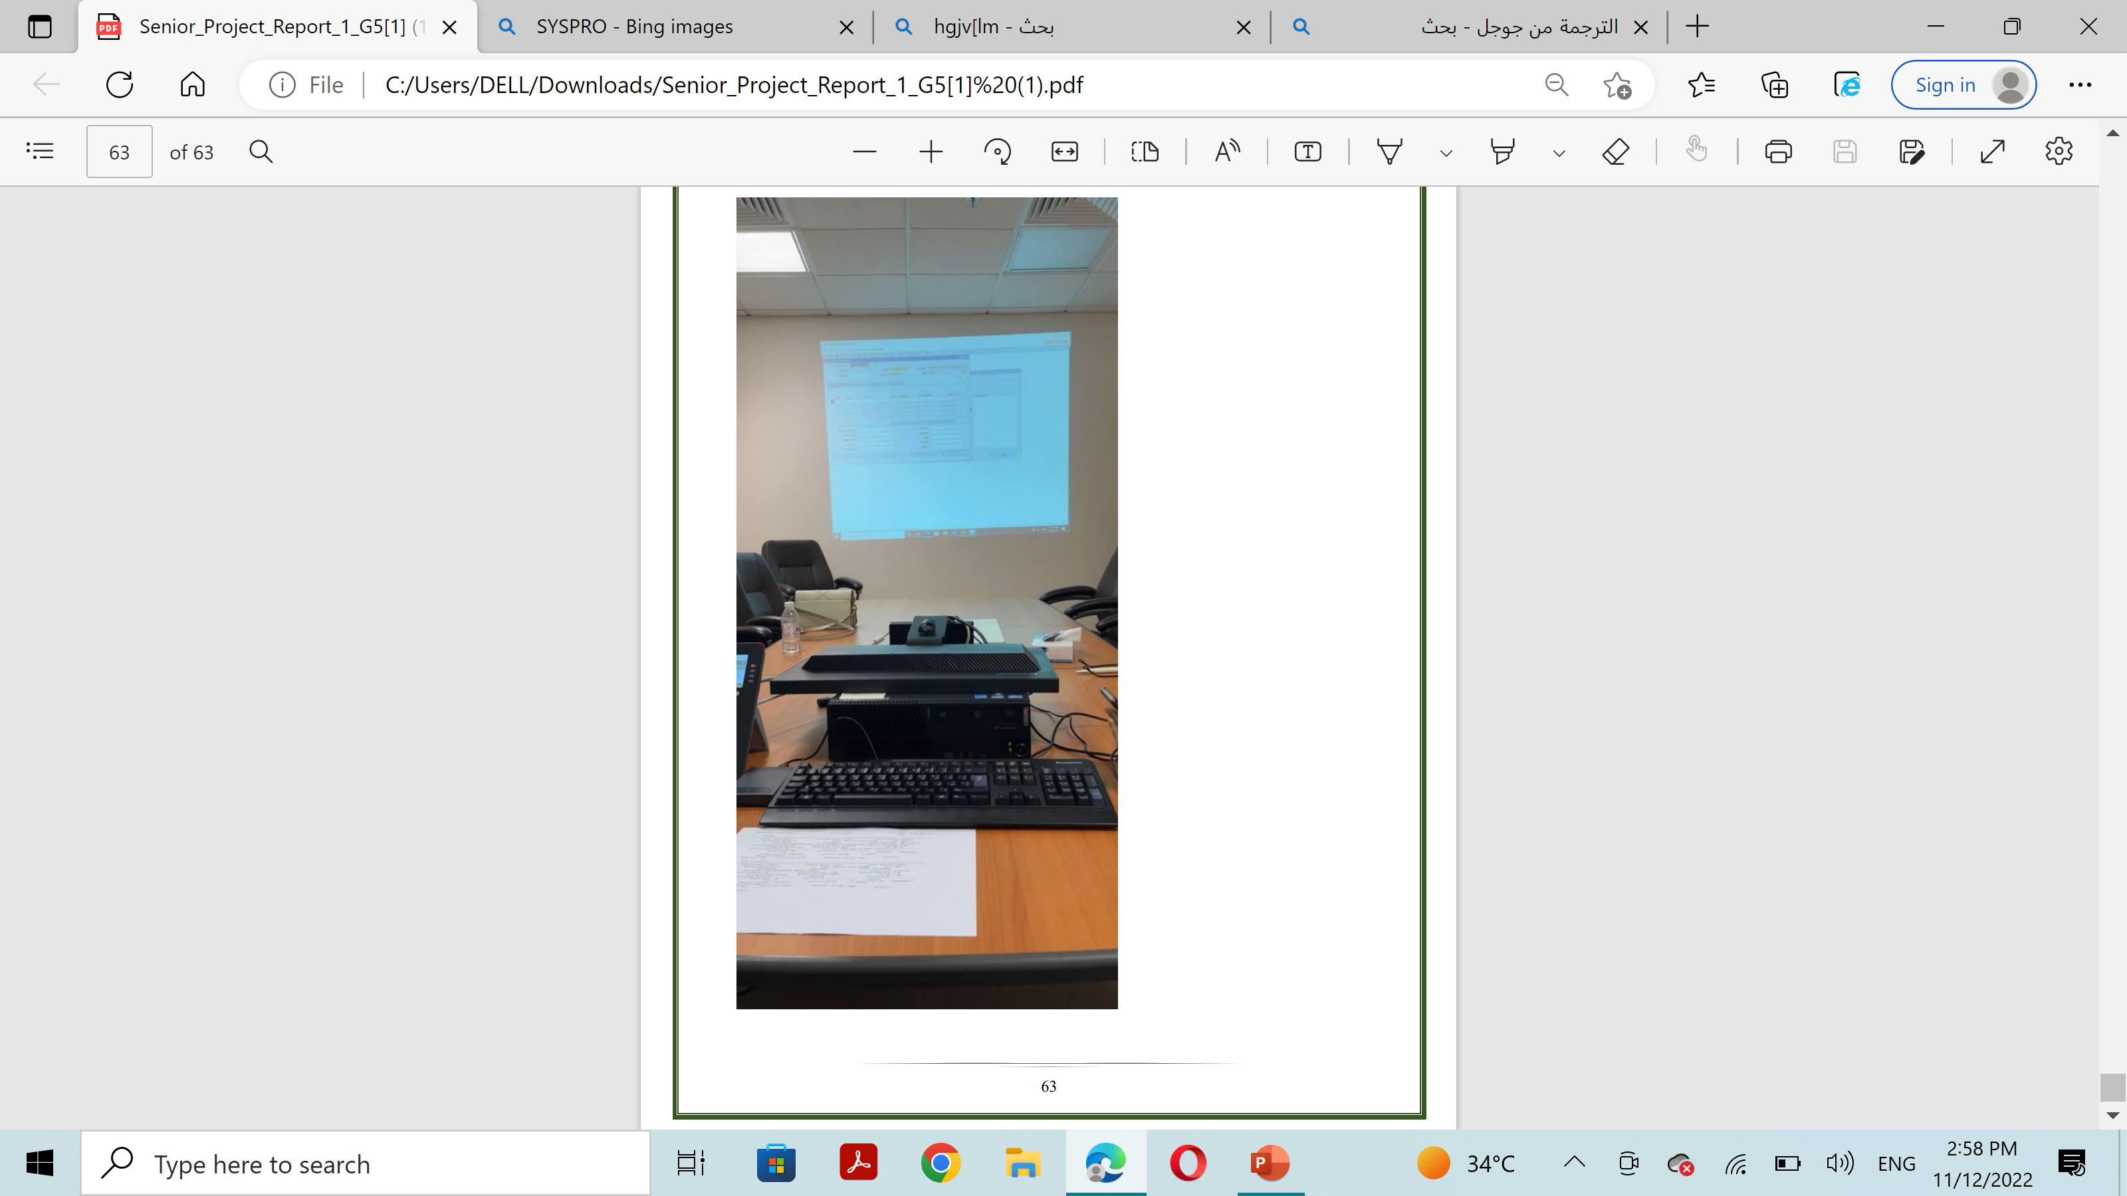
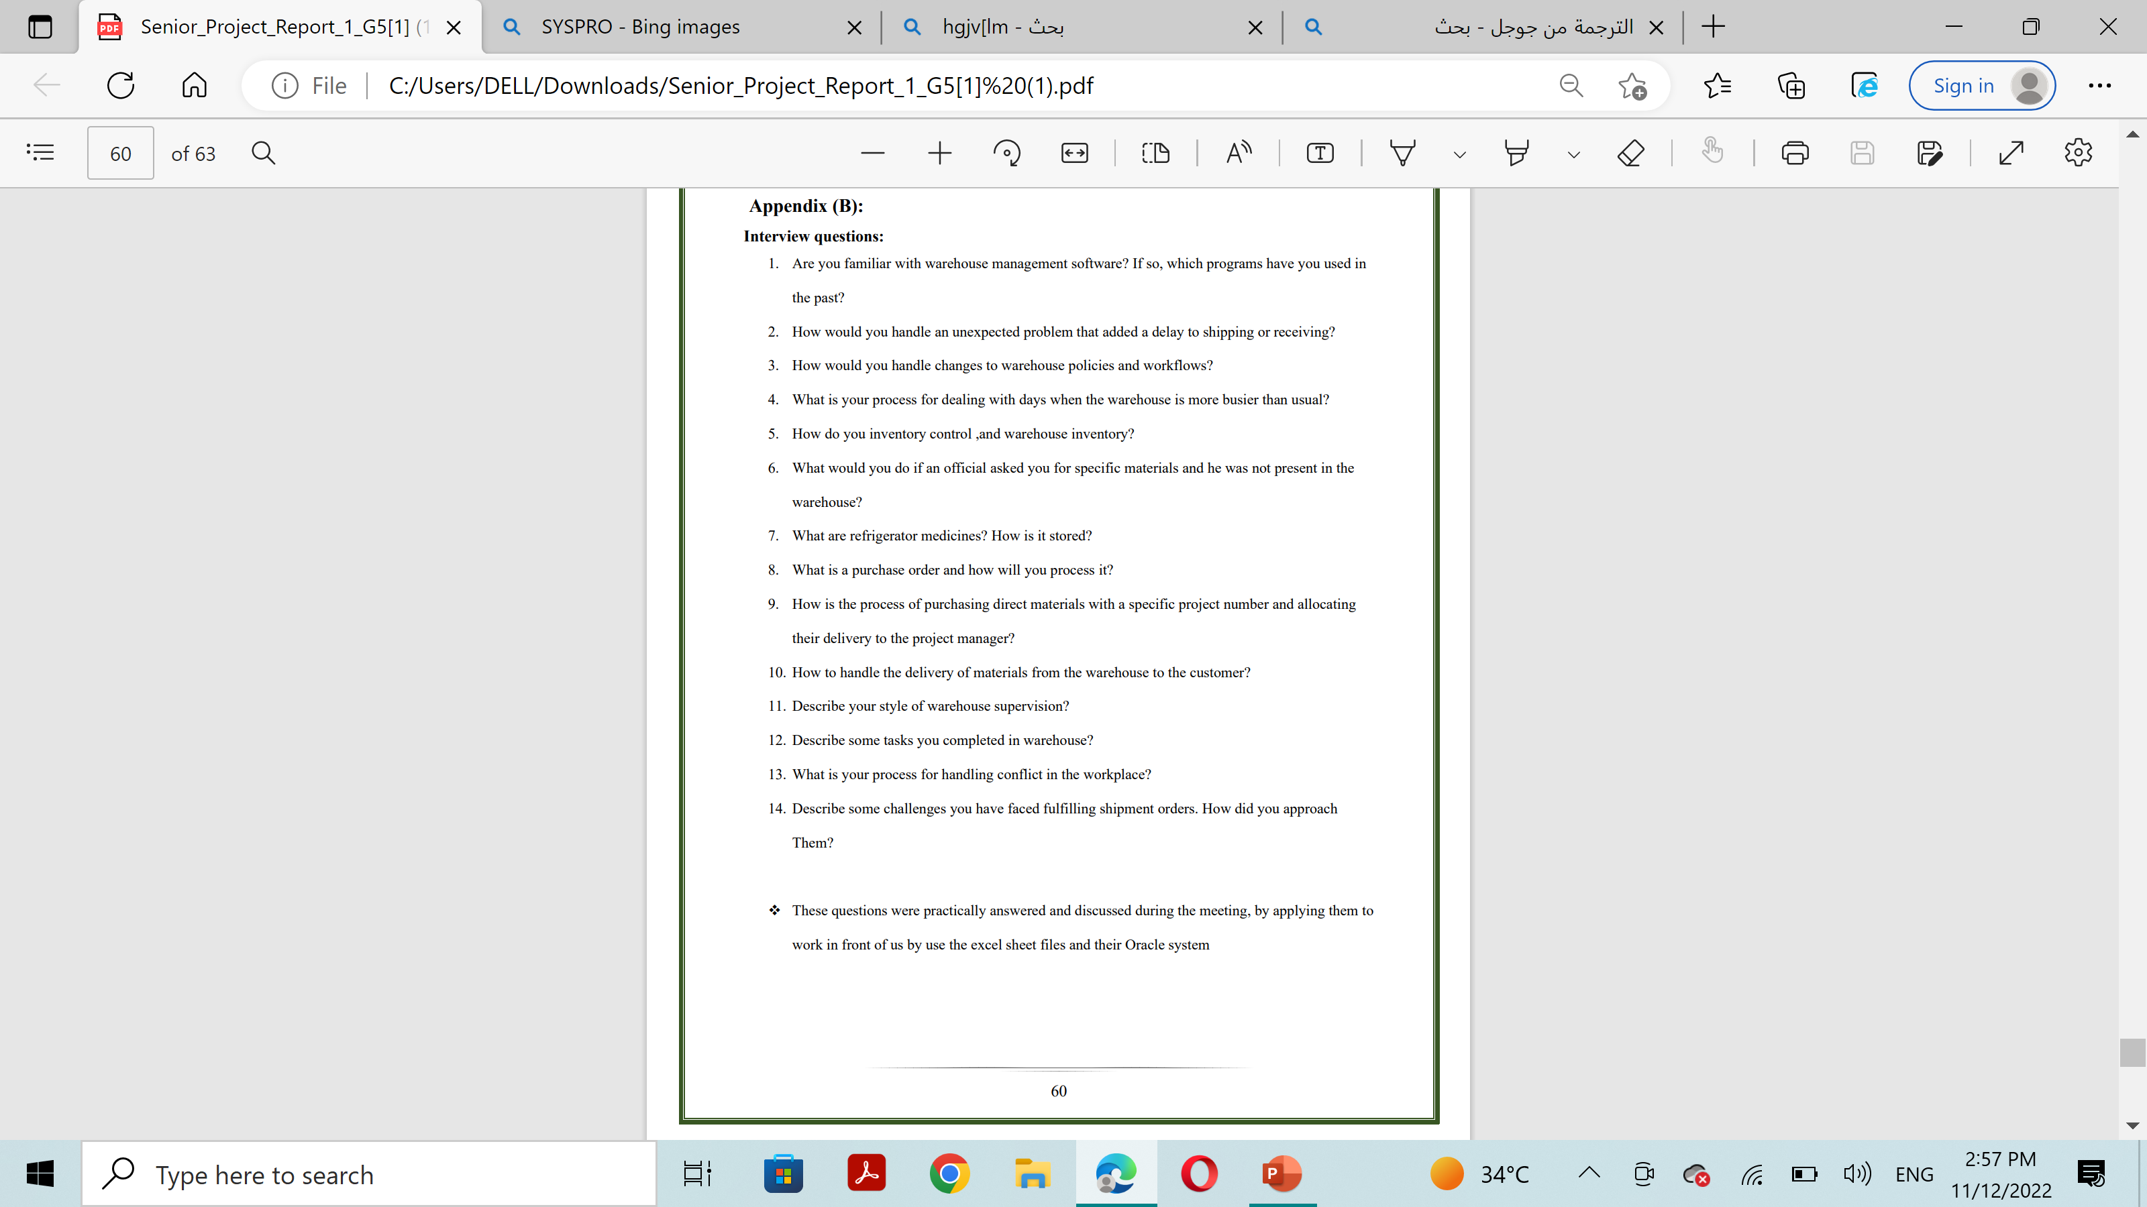
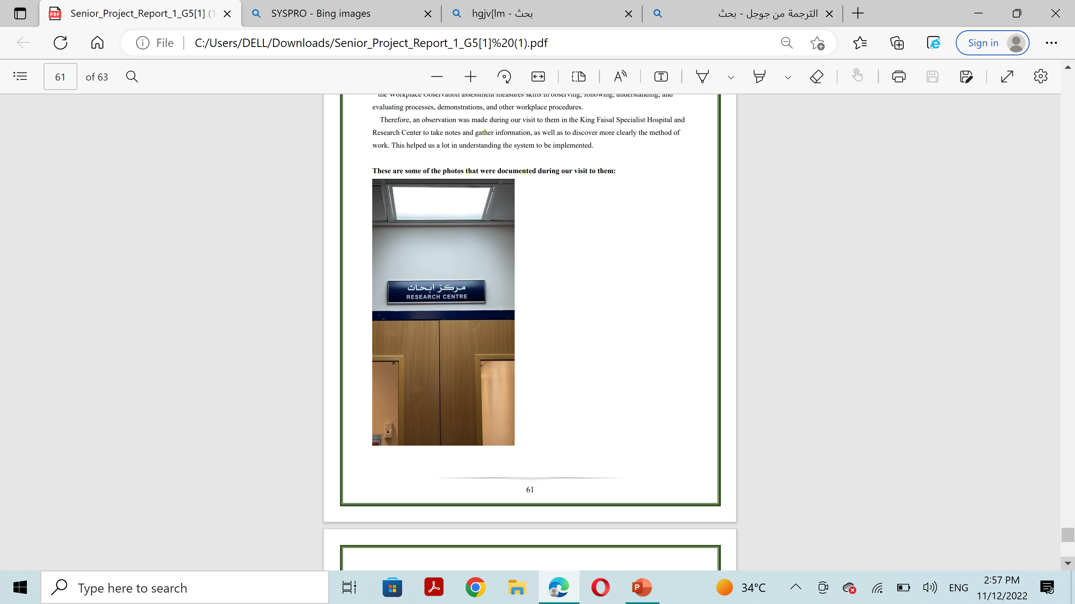
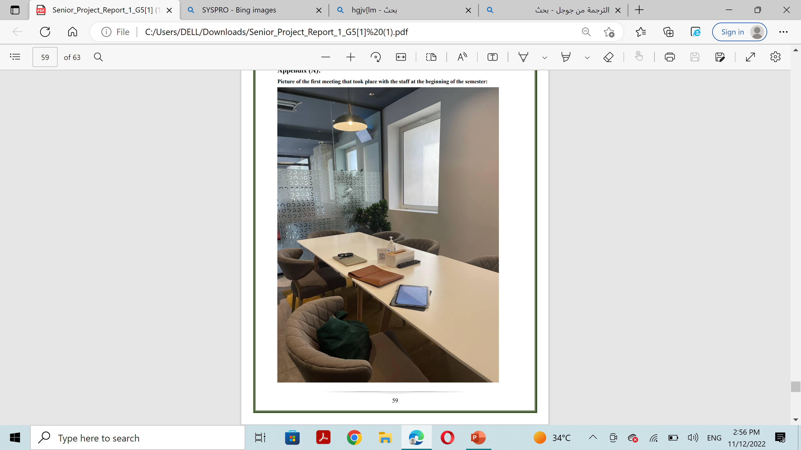
How collect the Requirment
Visit the customer's workplace
Interview
Questionnaire
1
2
3

Slide 11




Functional Requirment
The system shall allow the users to log into their account by entering their UserId and password.
The system shall allow the user to request an order.
The system shall allow users to create an account to register by entering a UserId/Email,
first and last name and their password
The system shall allow admin to insert the data of the received products.
The system shall allow to notifying an admin about new request.
The system shall allow to view a report to the administrator to review the requests and presence of the required products
The system shall allow the admin to notify the user about tracking information
The system shall allow the user to search for a product.
The system shall allow users who have projects to place an order and add the project number during the request.
The system shall allow to sends a notification to admin for the products that will be out of stock from the warehouse.
The system shall allow admin to browse for a product, to be purchased.
The system shall allow the admin to delete the request.

Slide 12
Non-Functional Requirment
Usability – Learnability : The interface of the system shall be understandable and easy to use.
Usability – User error protection :The system shall warn users via an error massage when users try to enter wrong inputs.
Usability- User error protection :The system shall show an error message when filling out the application form incorrectly
Security- Confidentiality: The system shall provide security for the private information of the storekeeper

Slide 13
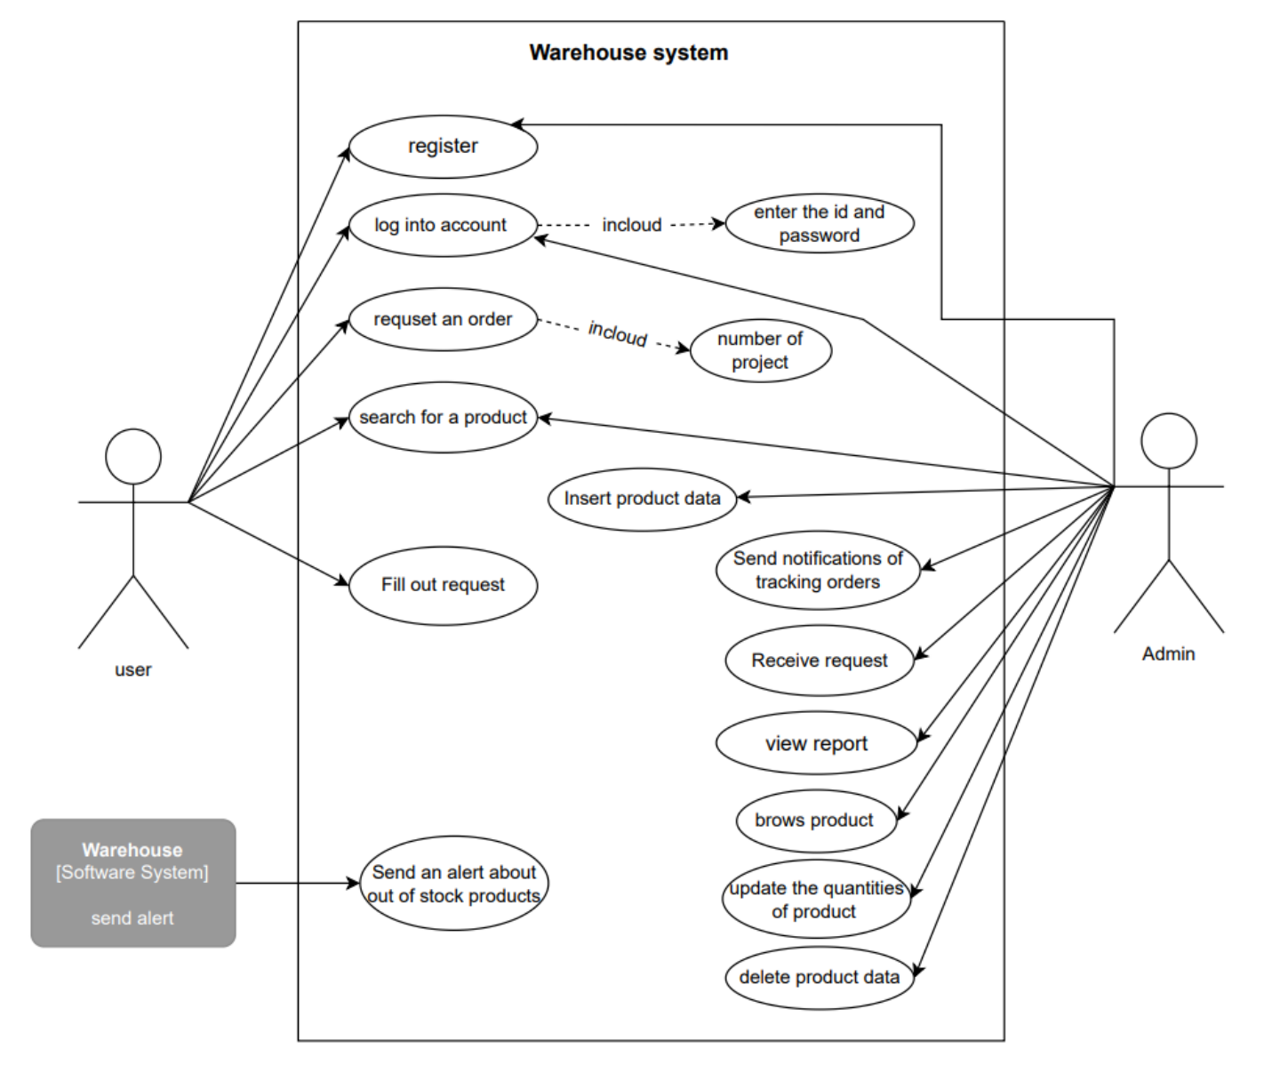
Usecase diagram

Slide 14
04
Analysis and design
In this section, we mentioned the class diagram to describe what must be present in the system being modeled. And sequence diagram to shows process interactions arranged in time sequence in the field of software engineering. It depicts the processes involved and the sequence of messages exchanged between the processes needed to carry out the functionality.

Slide 15
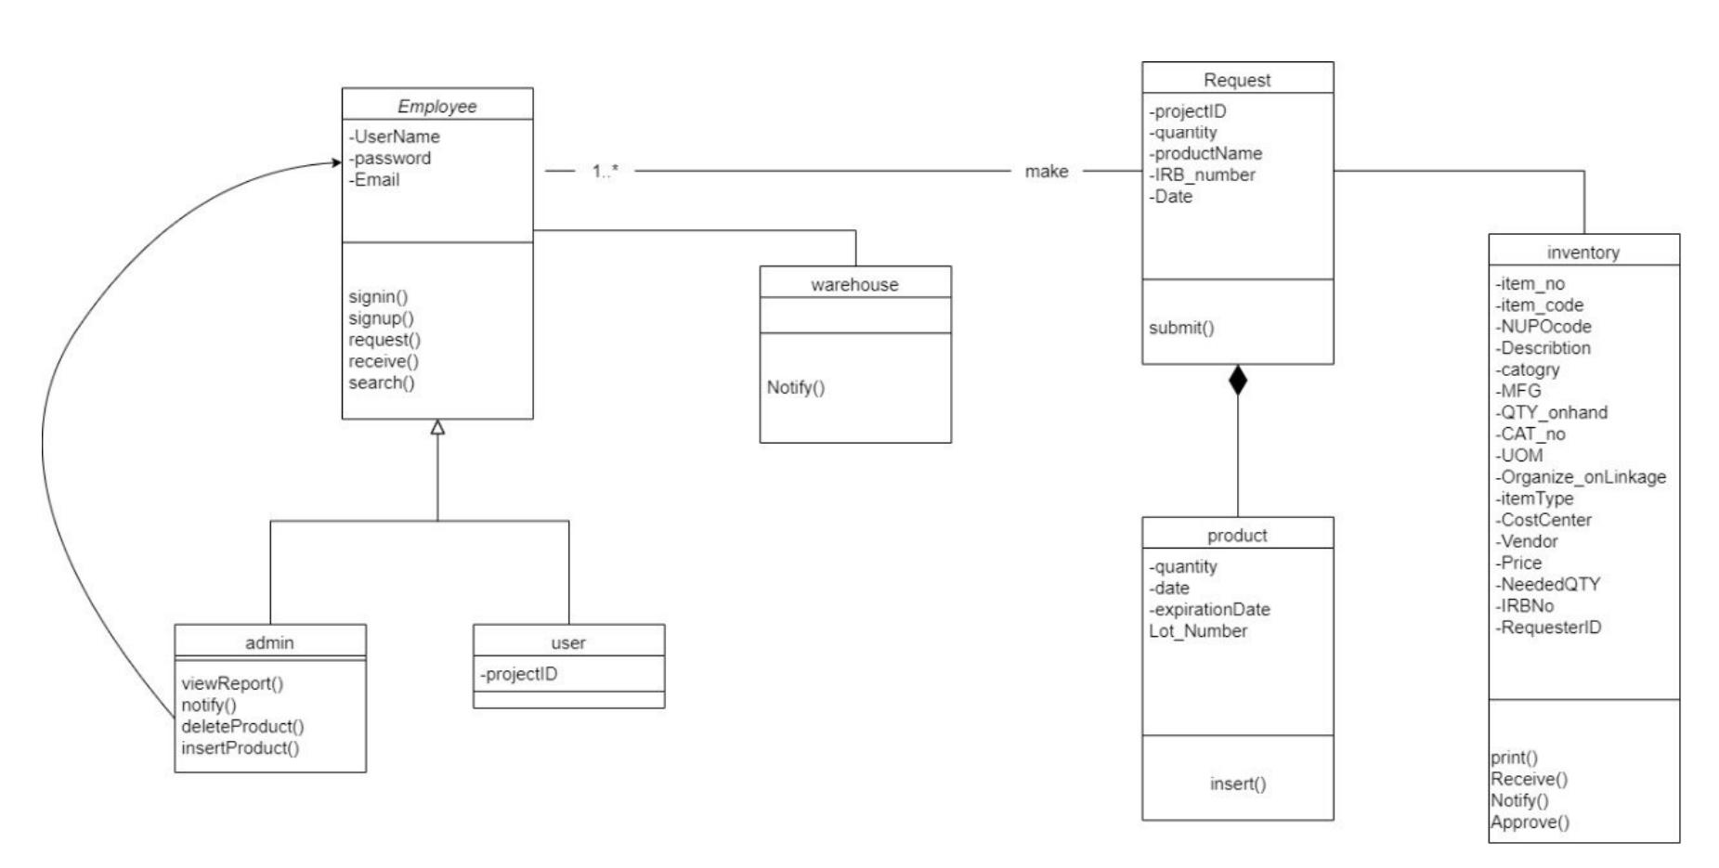
Class diagram

Slide 16
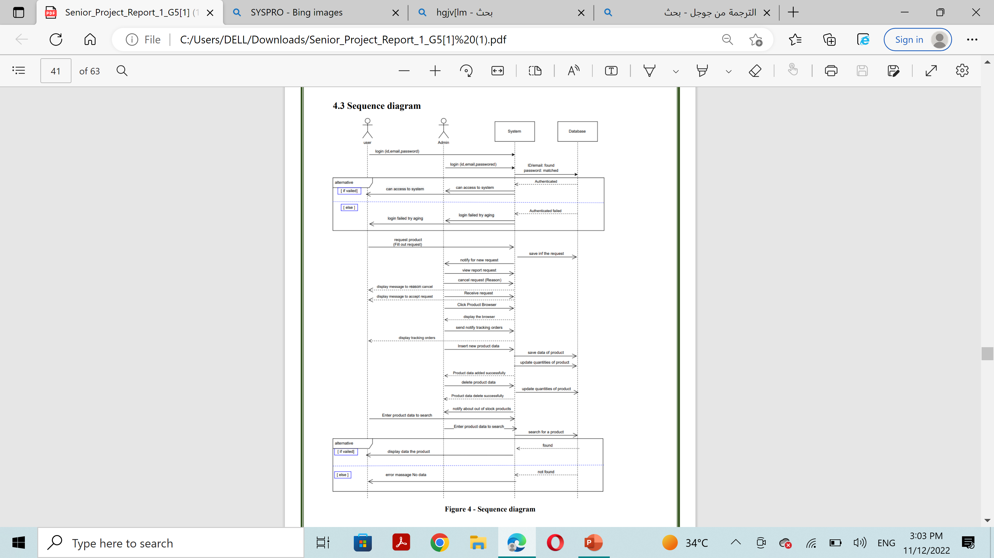
sequence diagram

Slide 17
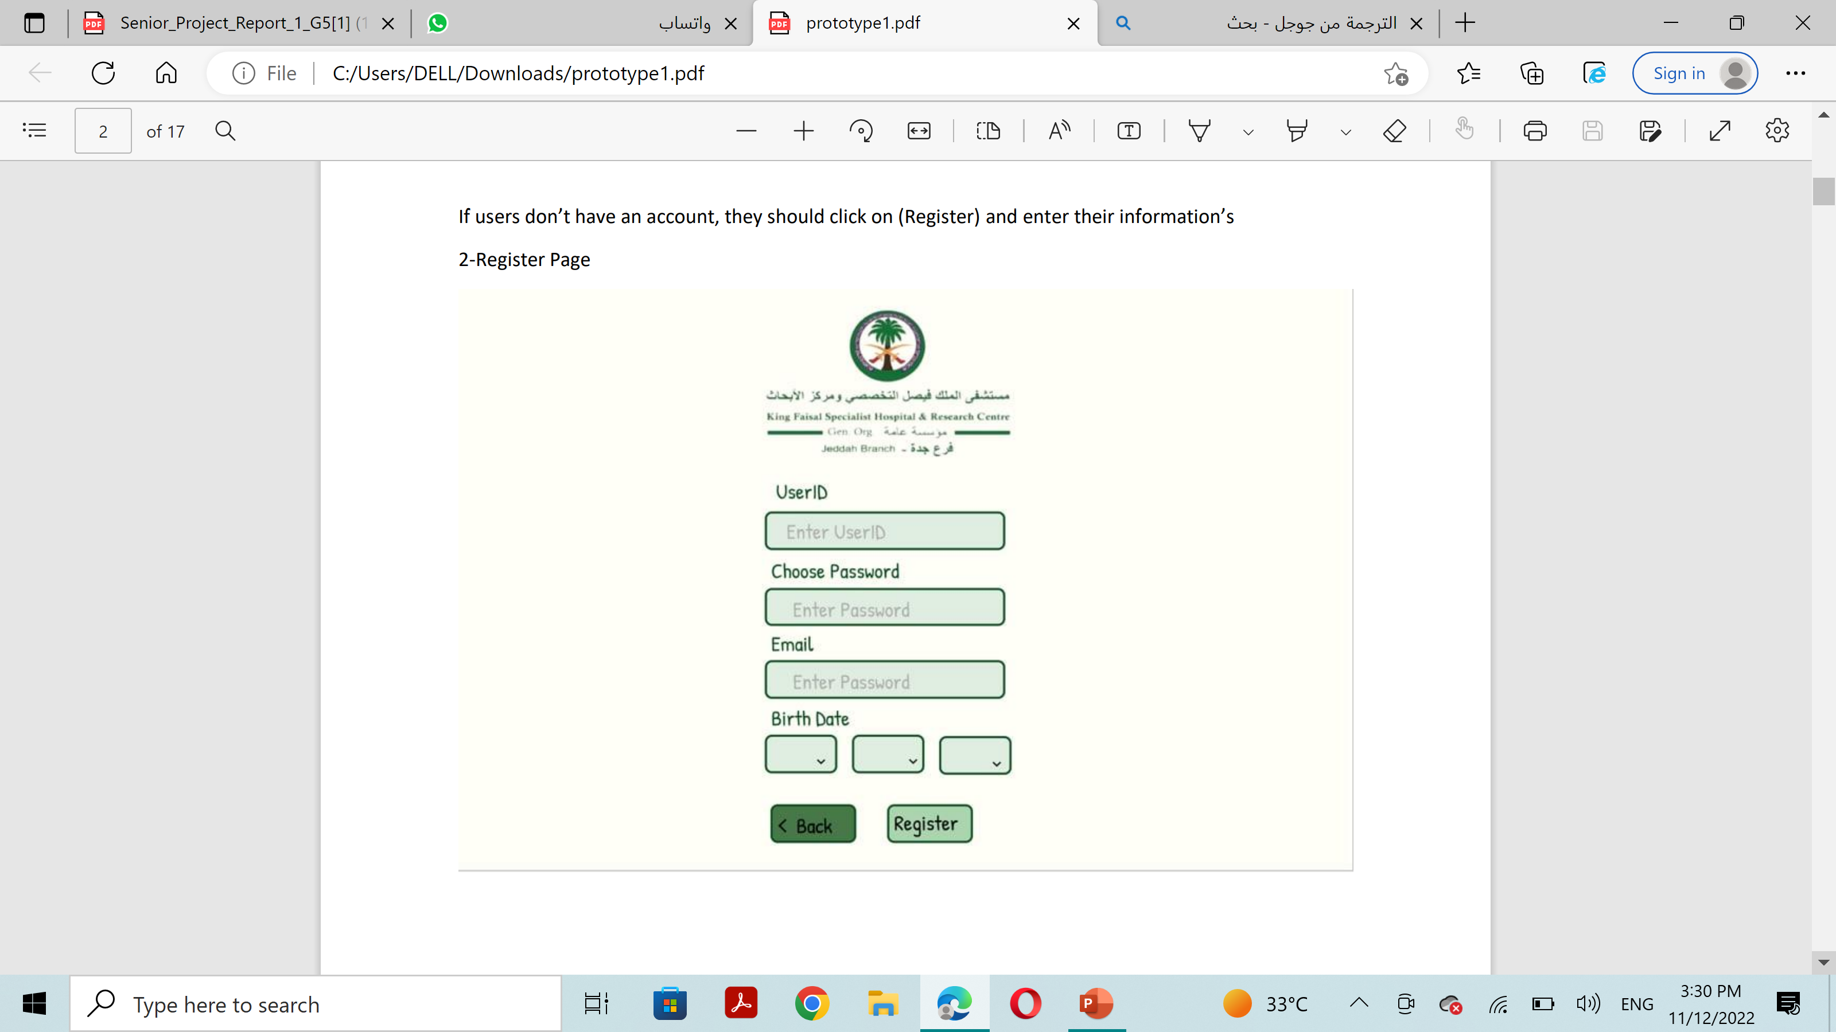
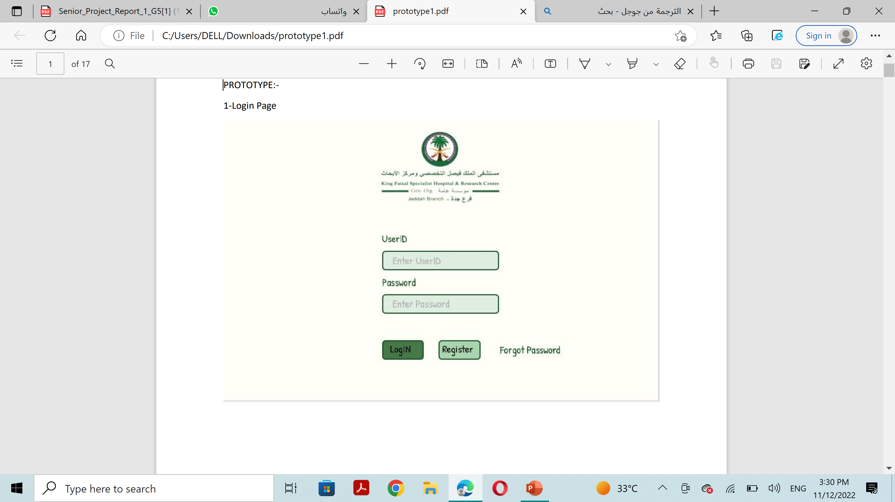
Prototype (user view)

Slide 18
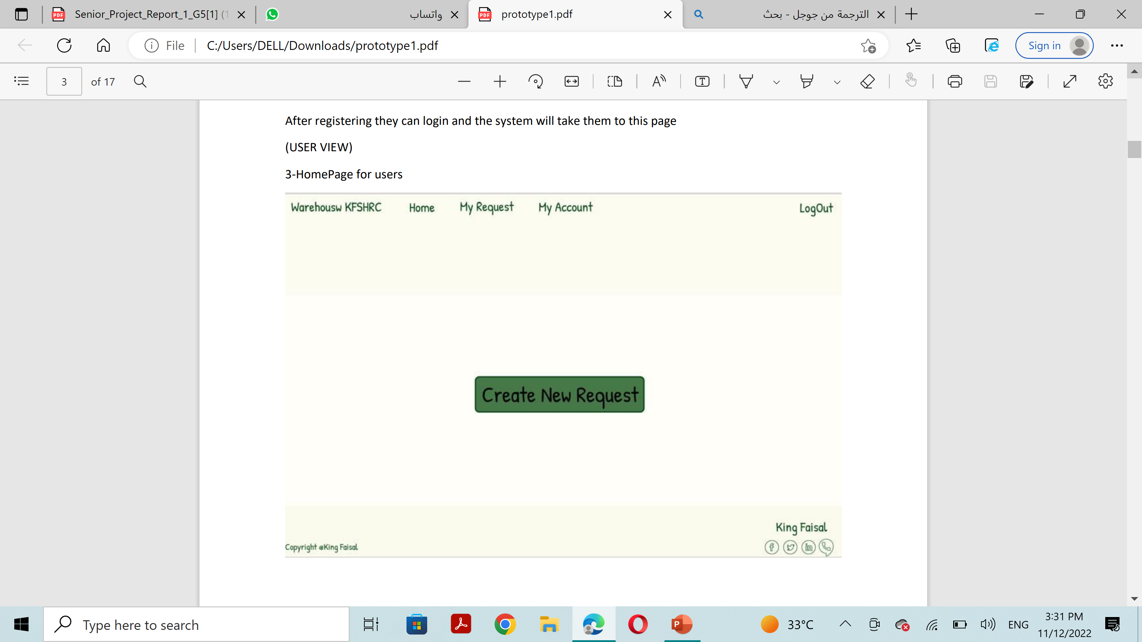
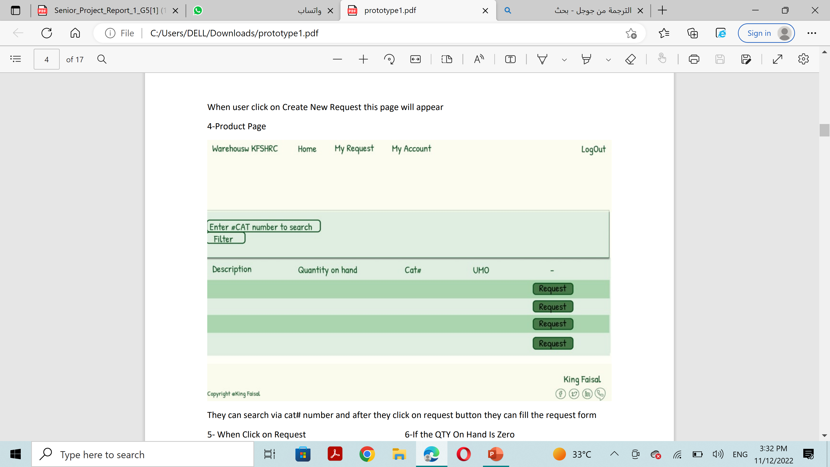
Prototype (user view)

Slide 19
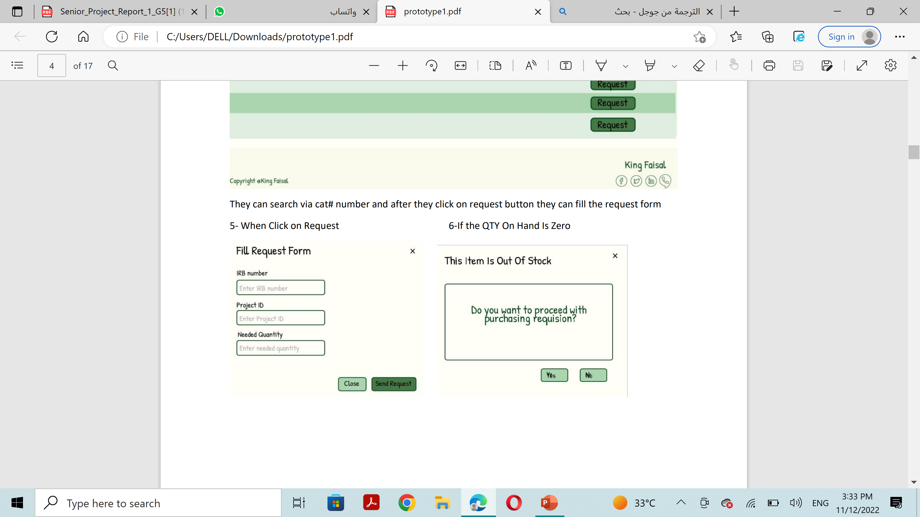
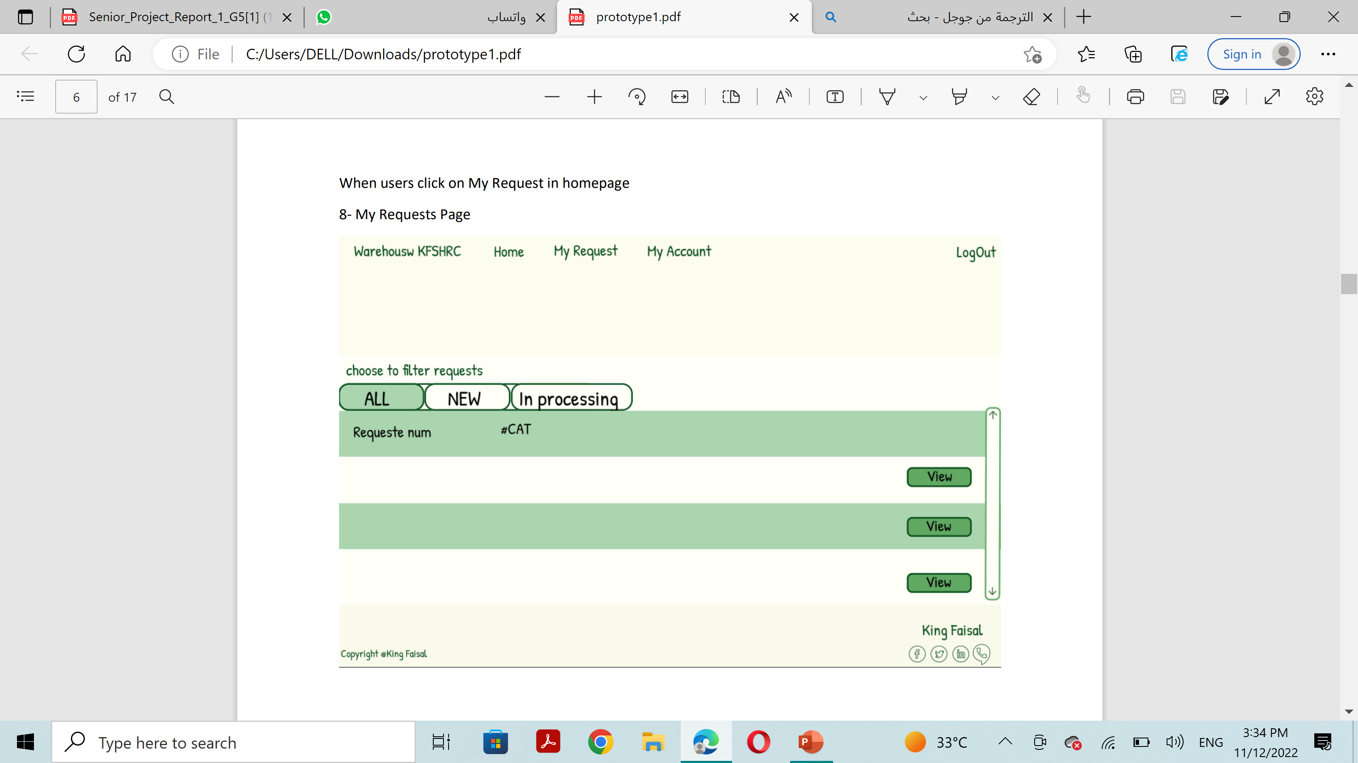
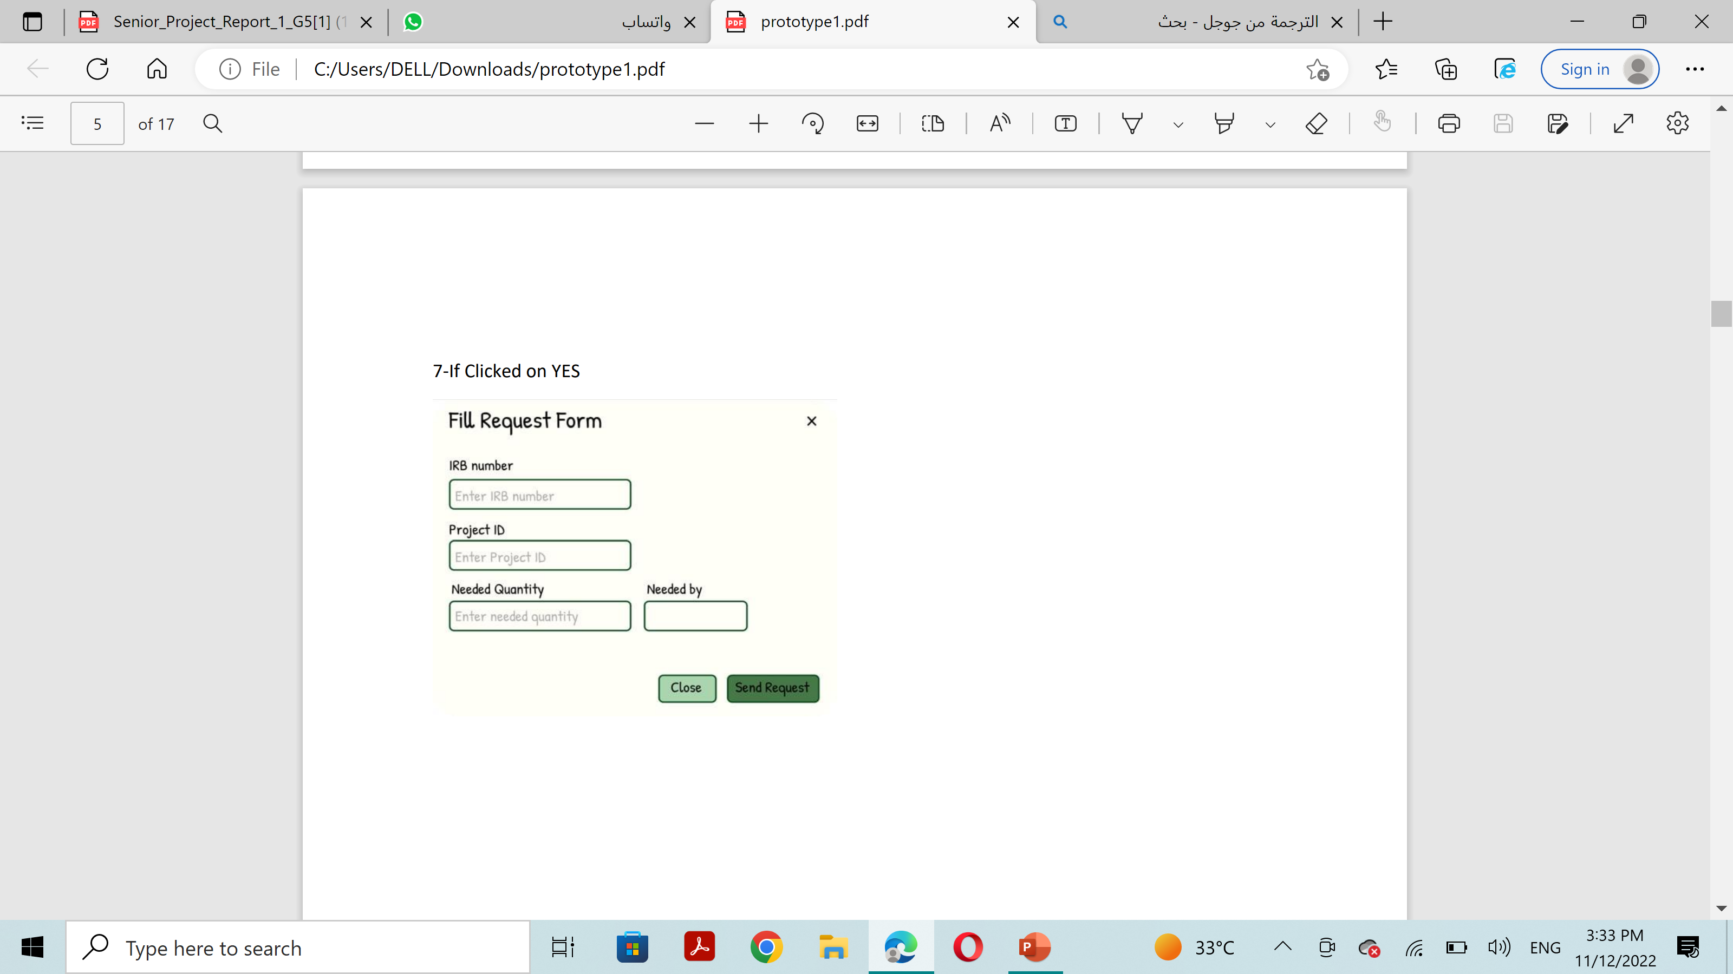
Prototype (user view)

Slide 20
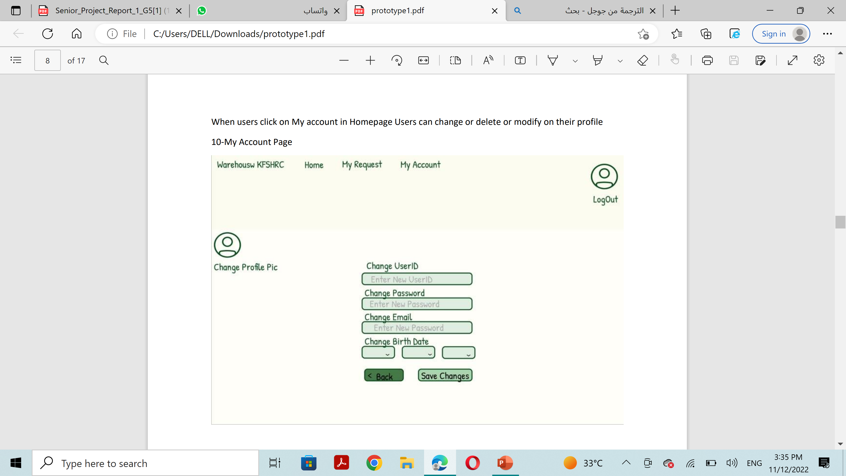
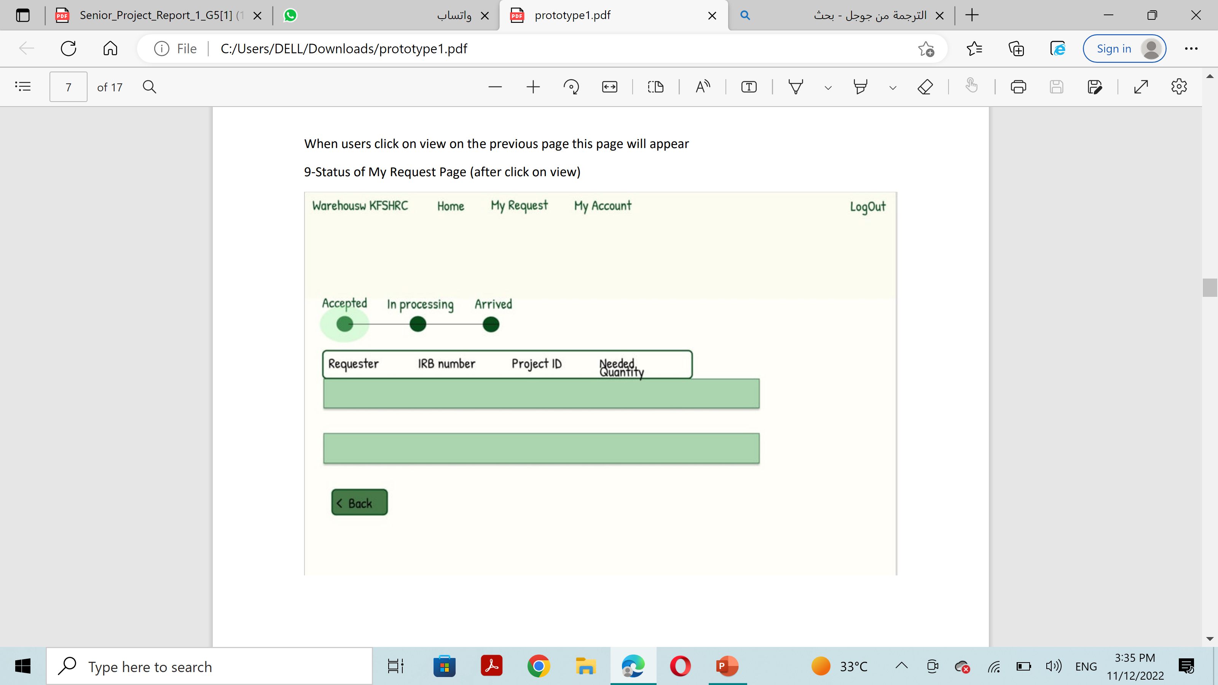
Prototype (user view)

Slide 21
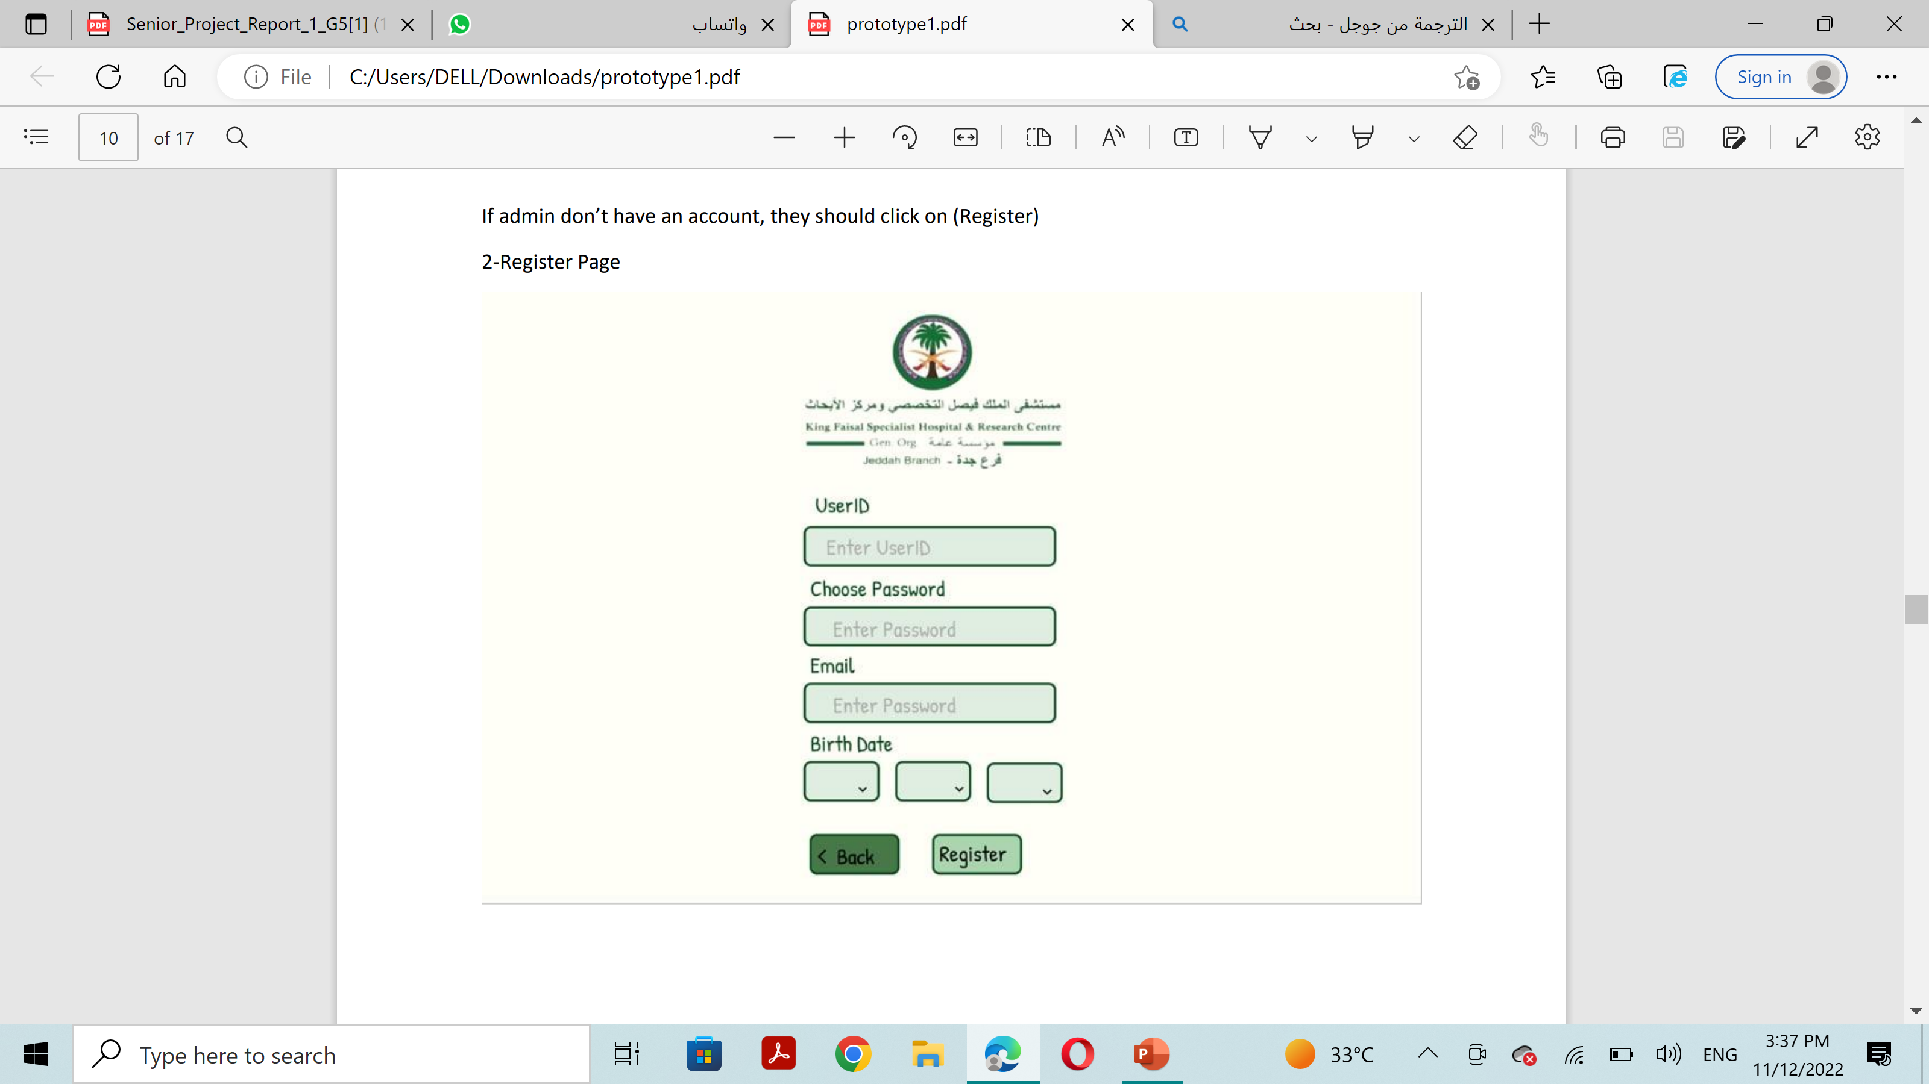
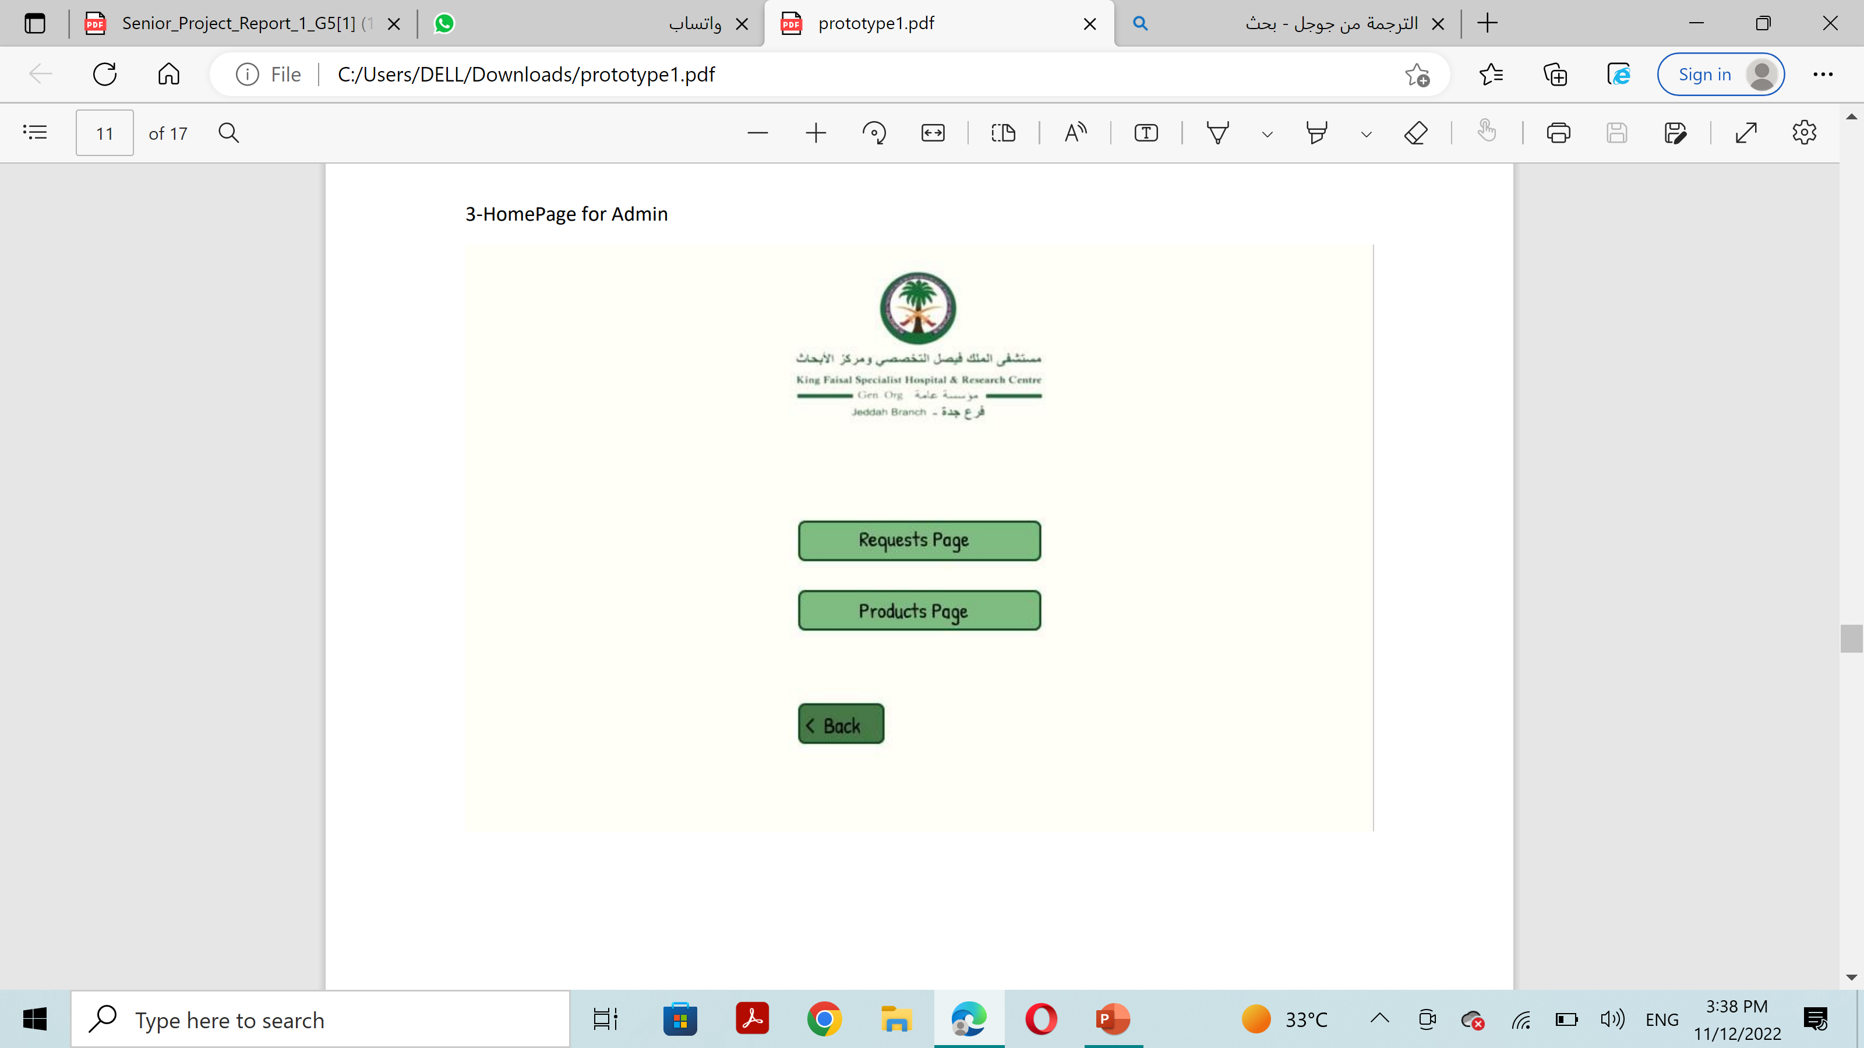
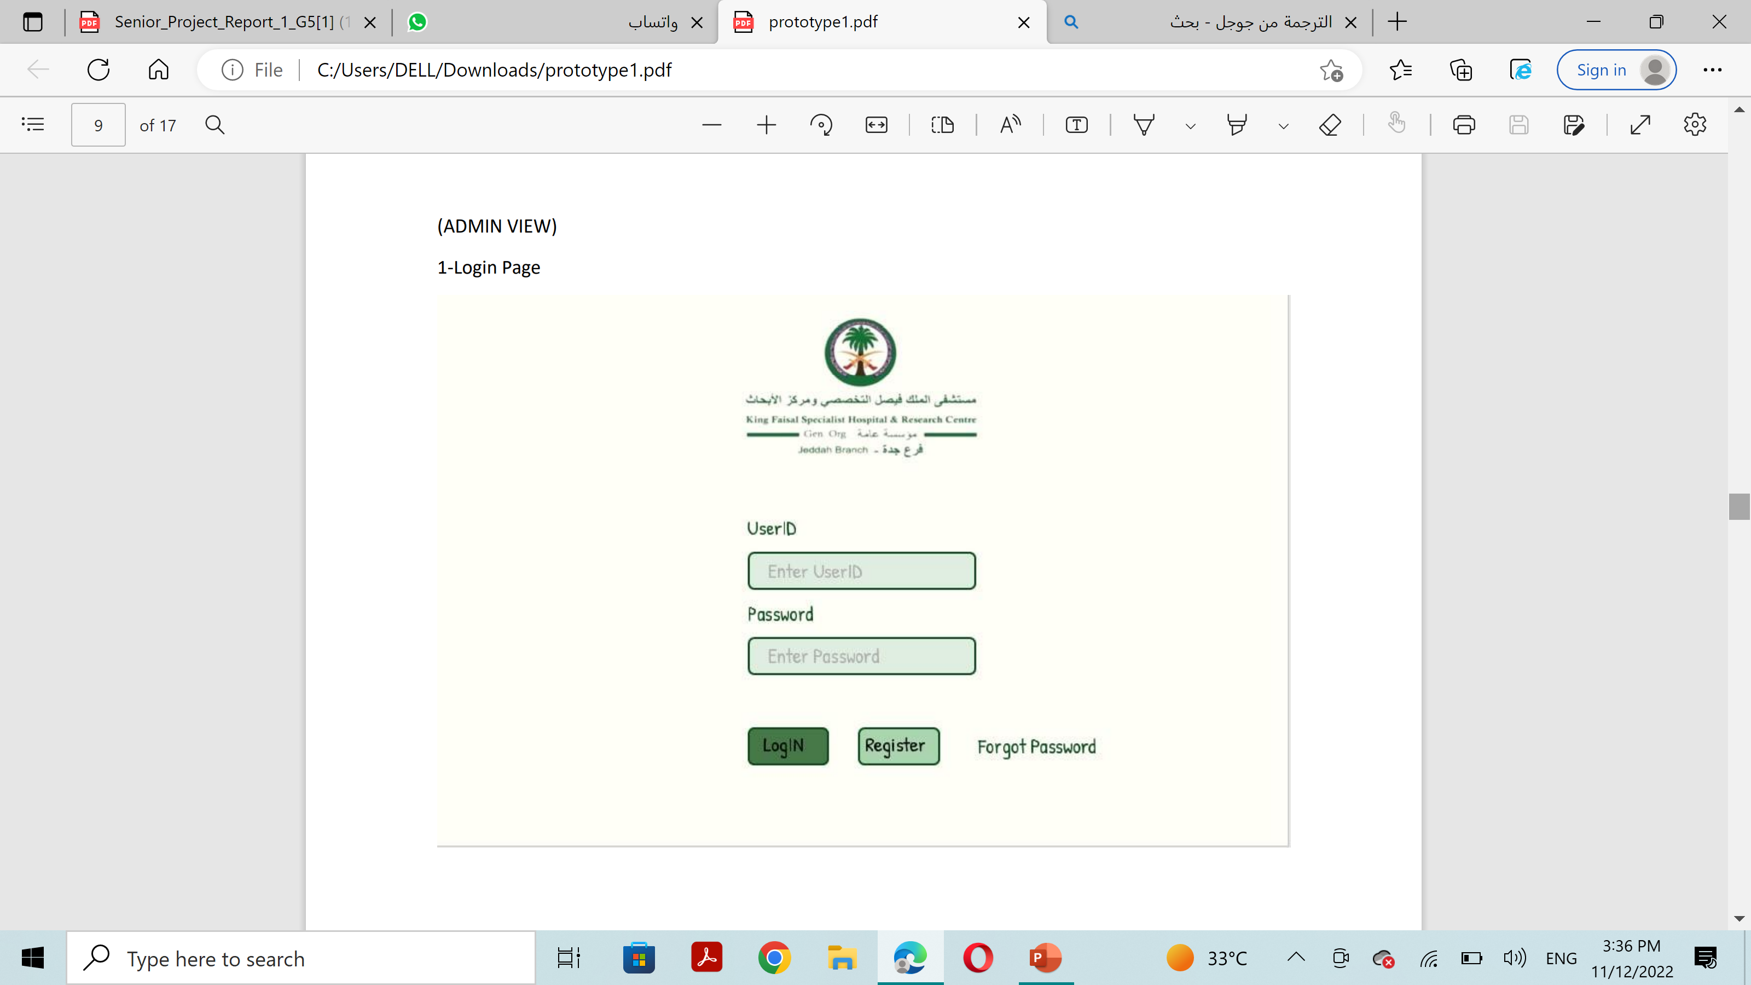
Prototype(Admin View)

Slide 22
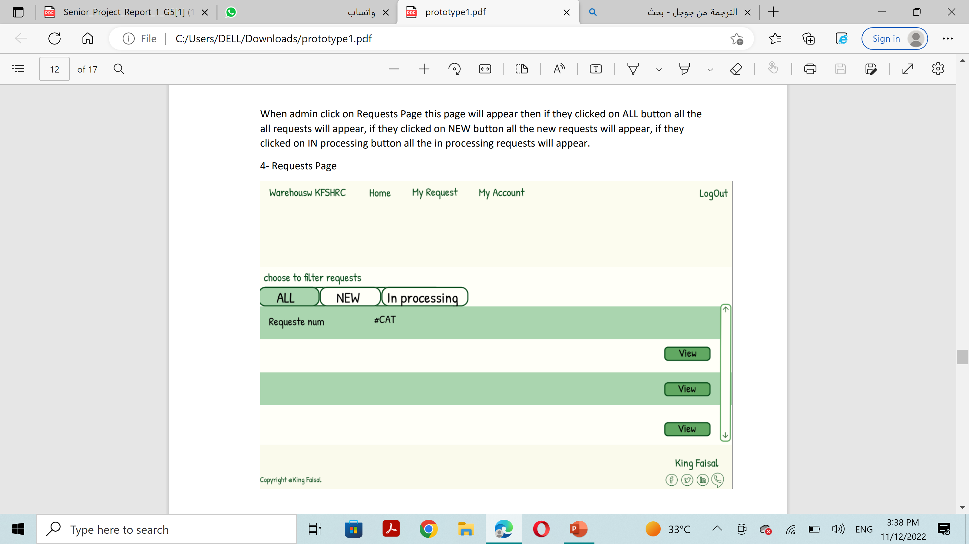
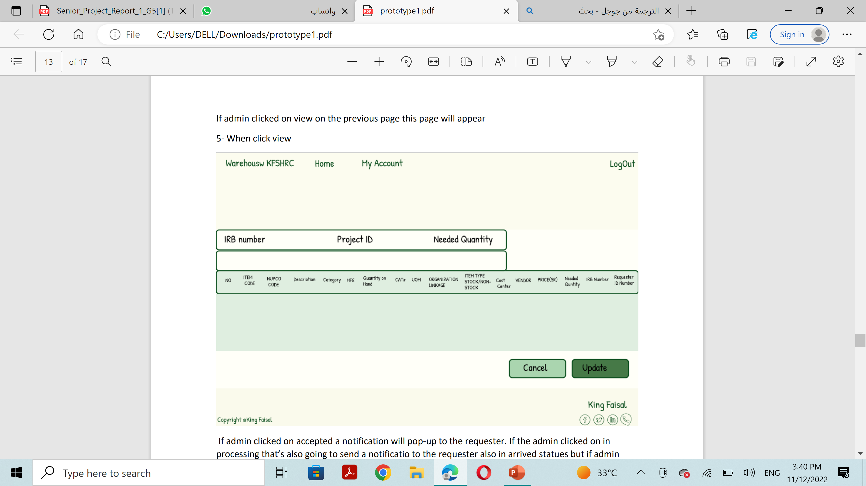
Prototype(Admin View)

Slide 23
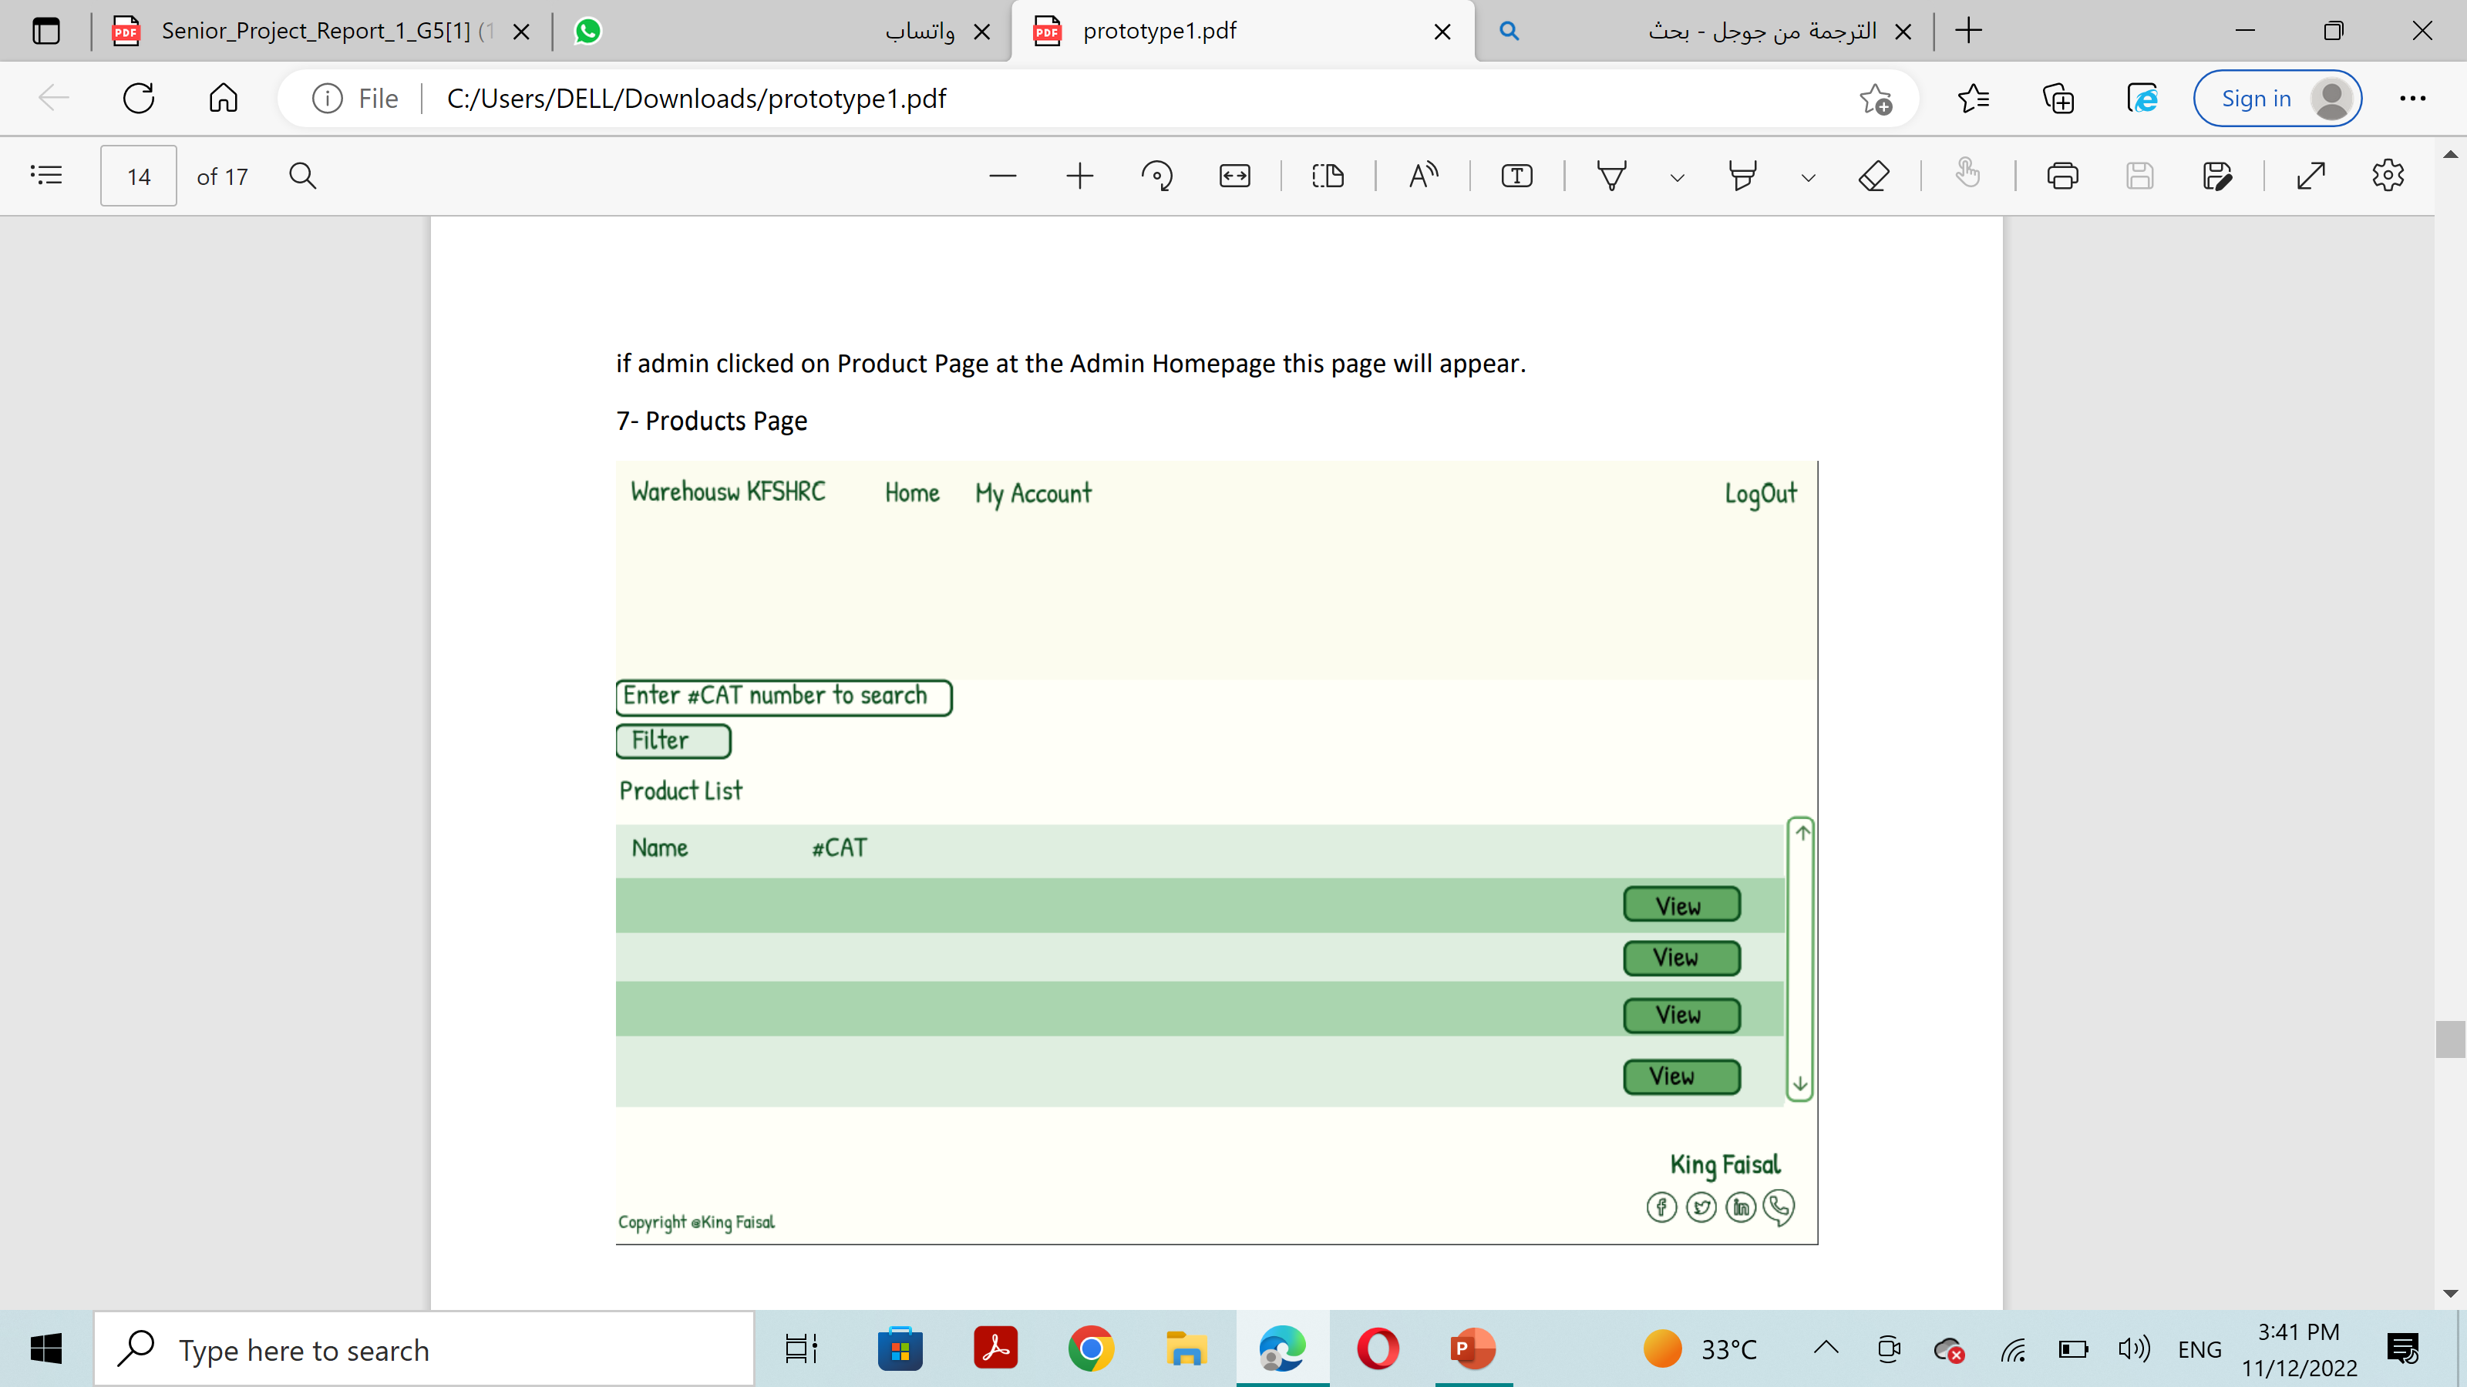
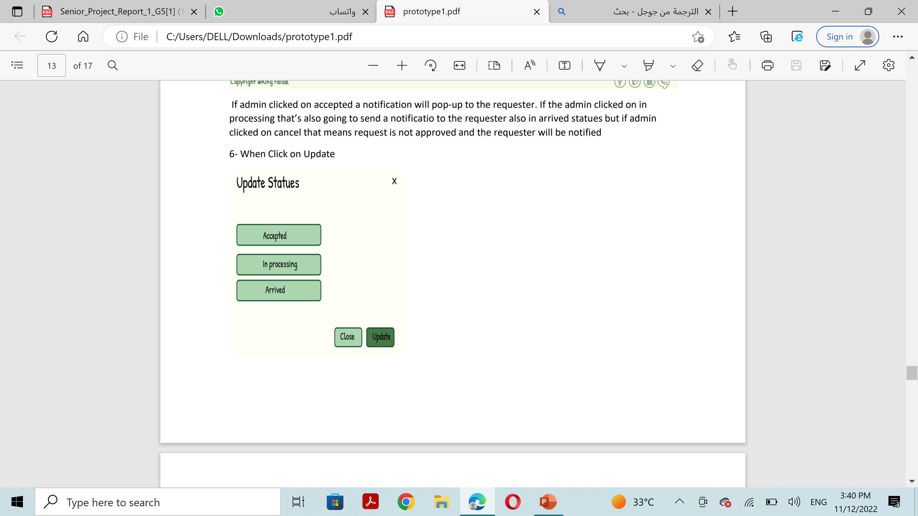
Prototype(Admin View)

Slide 24
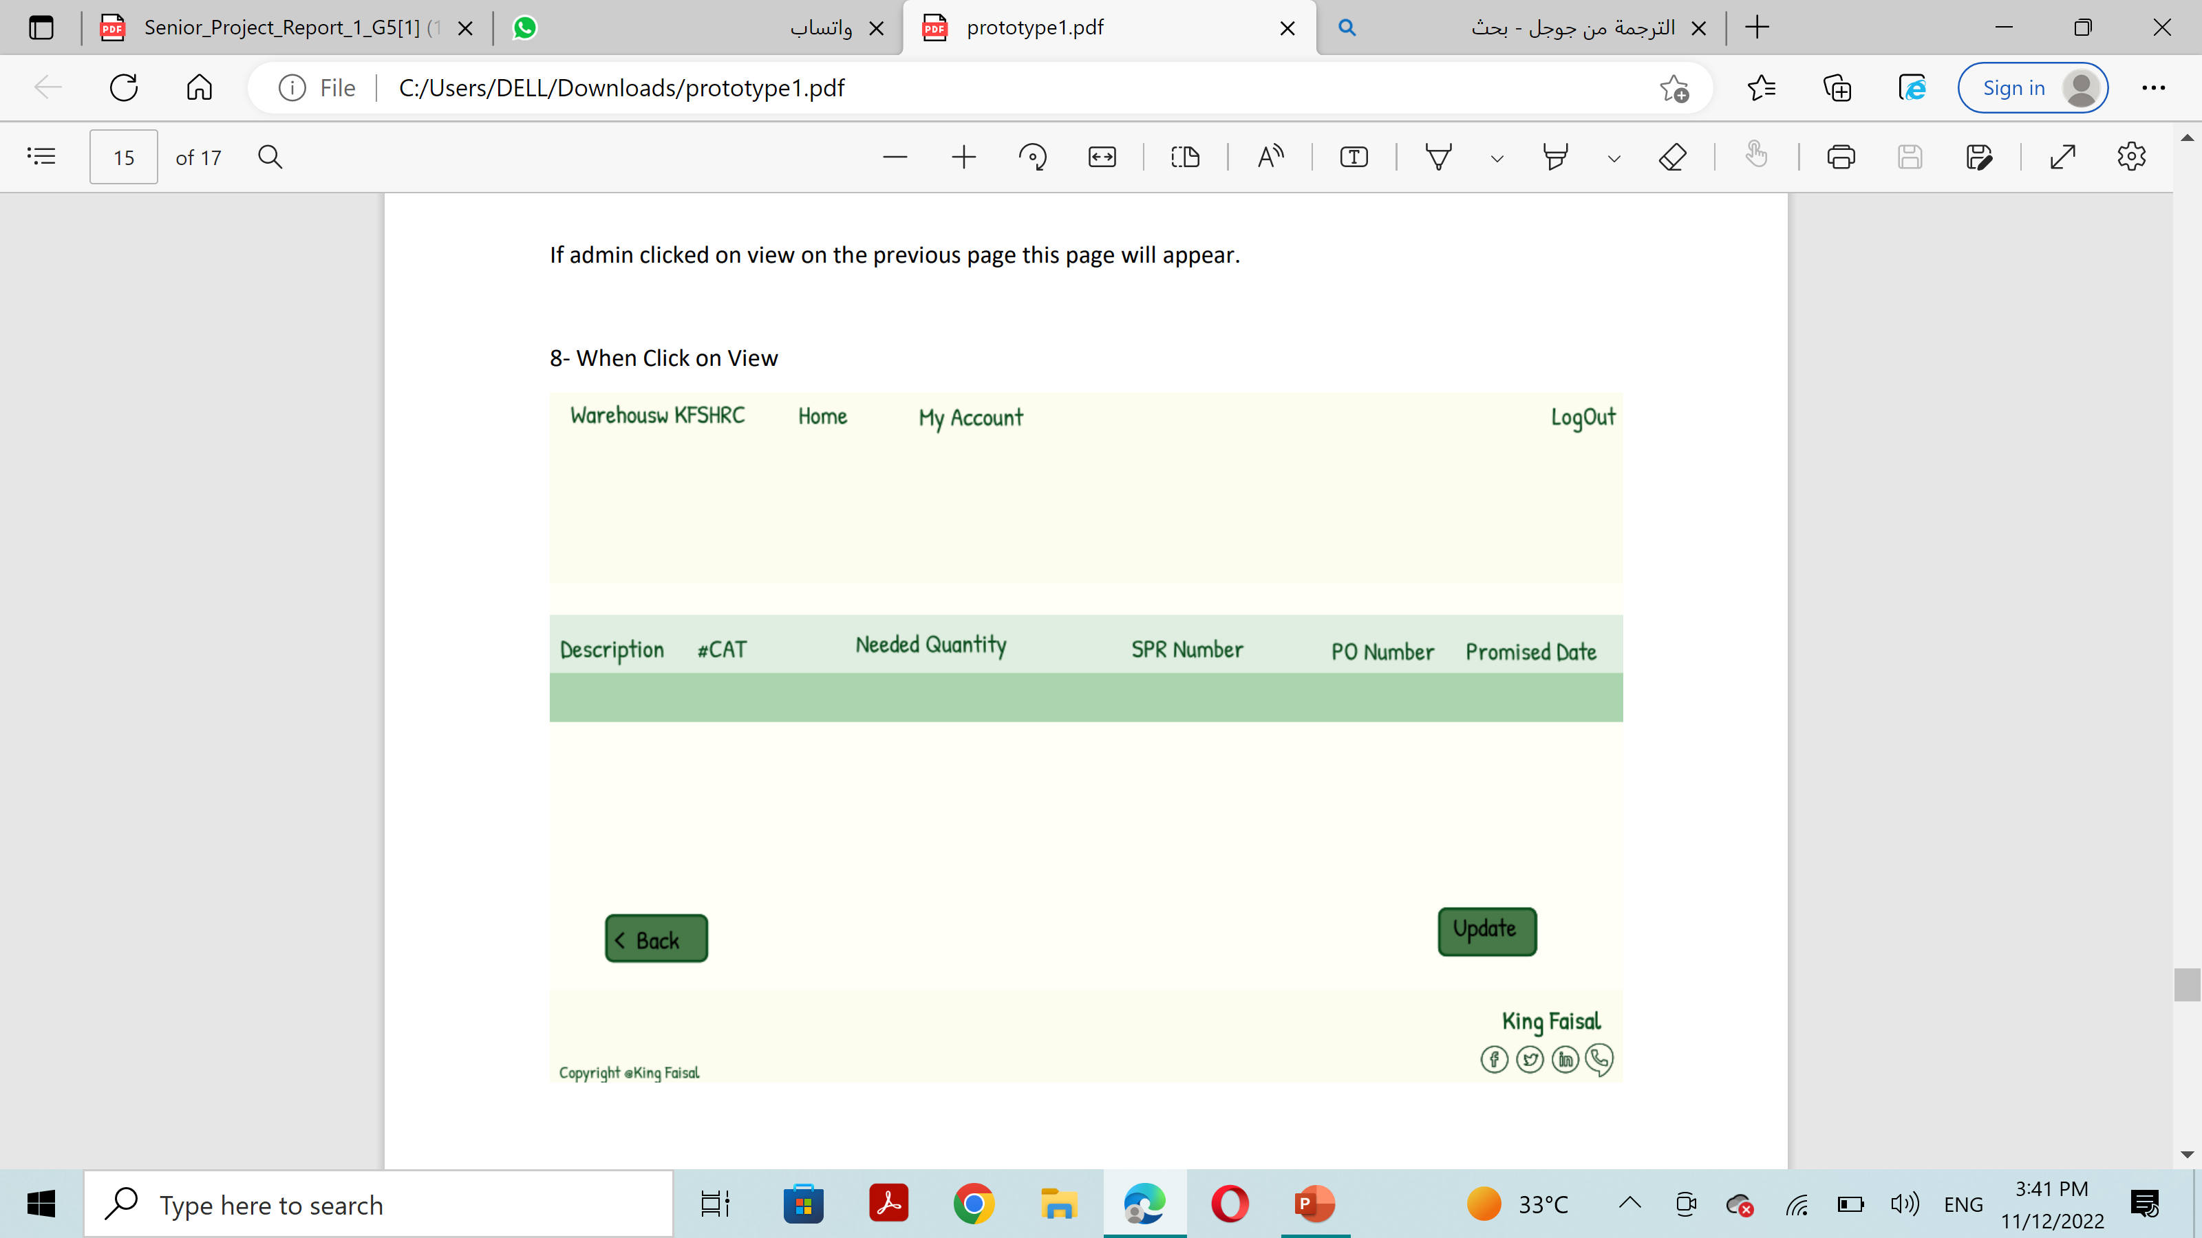
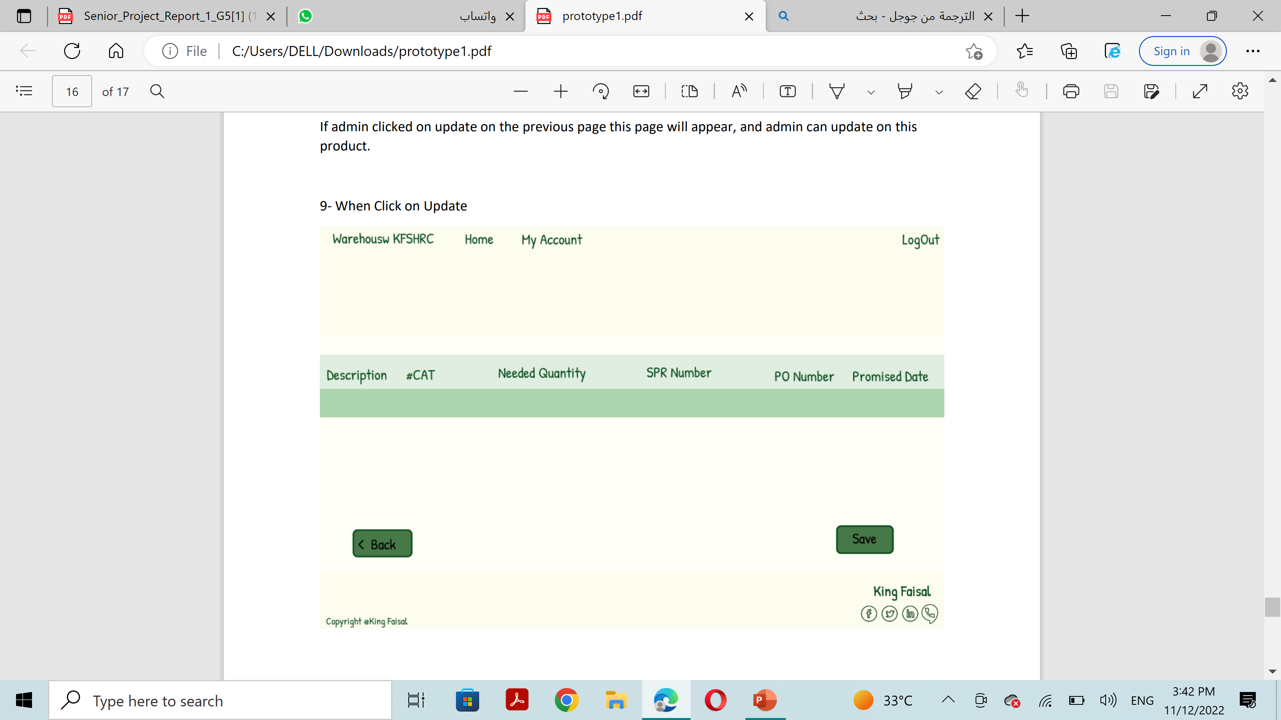
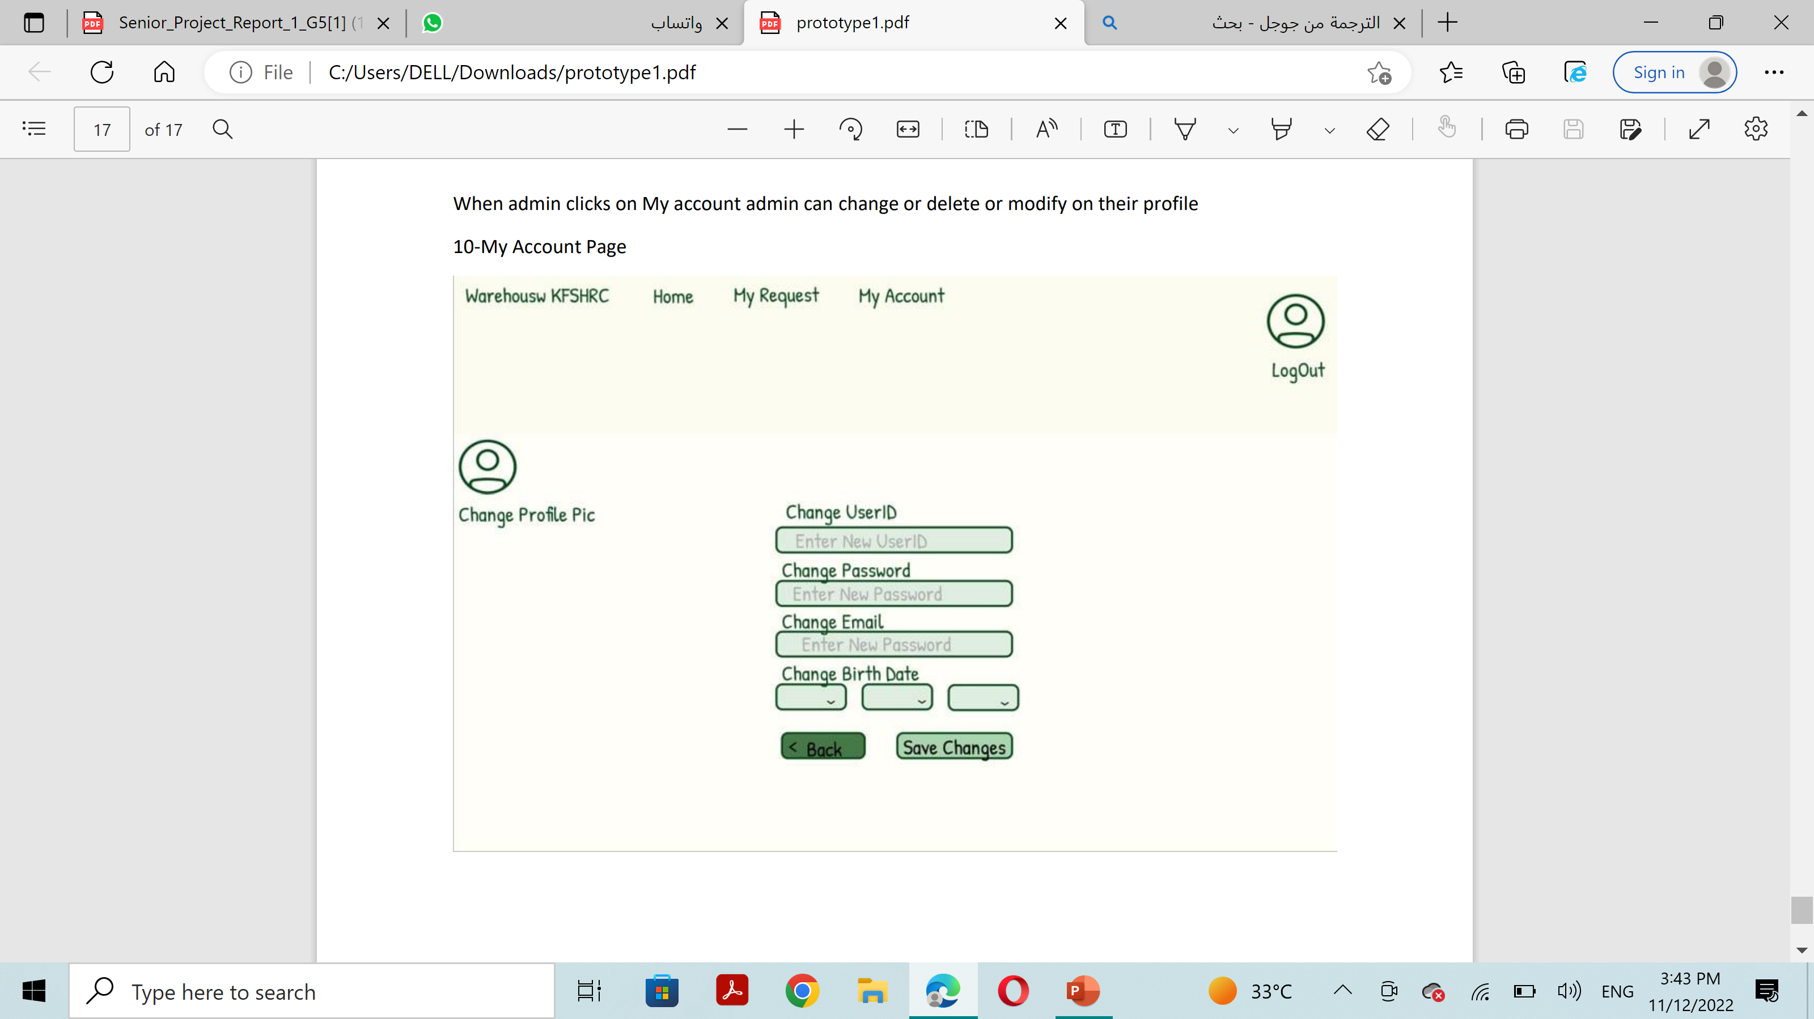
Prototype(Admin View)

Slide 25
The sprint
05
In this secion, two high-priority project requirements were identified, work tasks were divided using Scrum to plan and organize tasks, and everyone was involved in carrying out the tasks. This report for Sprint 1 contains all the following stages: Requirements Gathering and Analysis, Analysis and Design, Implementation, Testing

Slide 26
Product backlog
Requirements to be implemented for this sprint:
• The system shall allow the user to request an order.
• The system shall allow the user to search for a product.

Slide 27
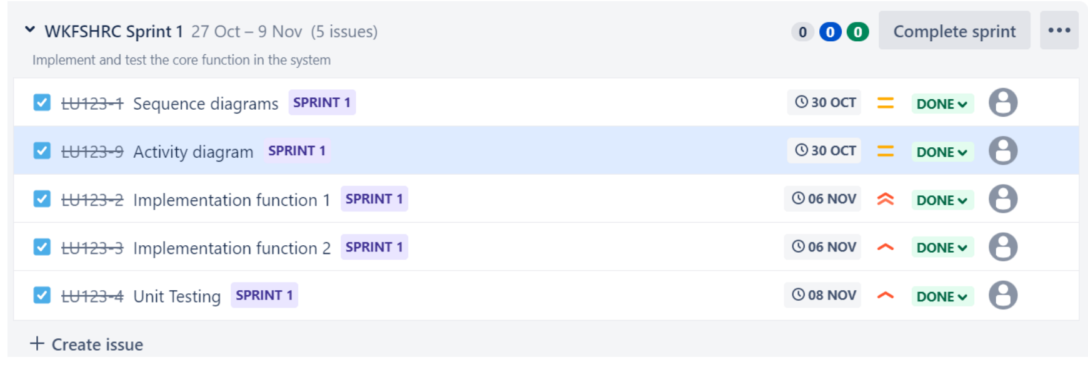
Sprint backlog

Slide 28
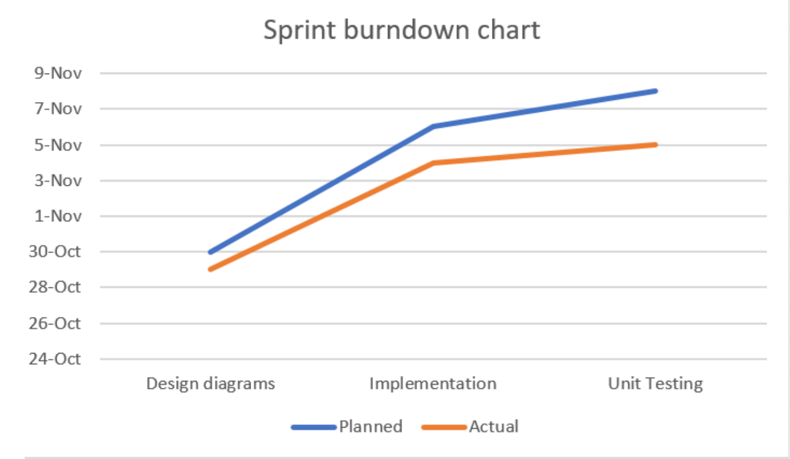
Sprint Burndown chart:

Slide 29
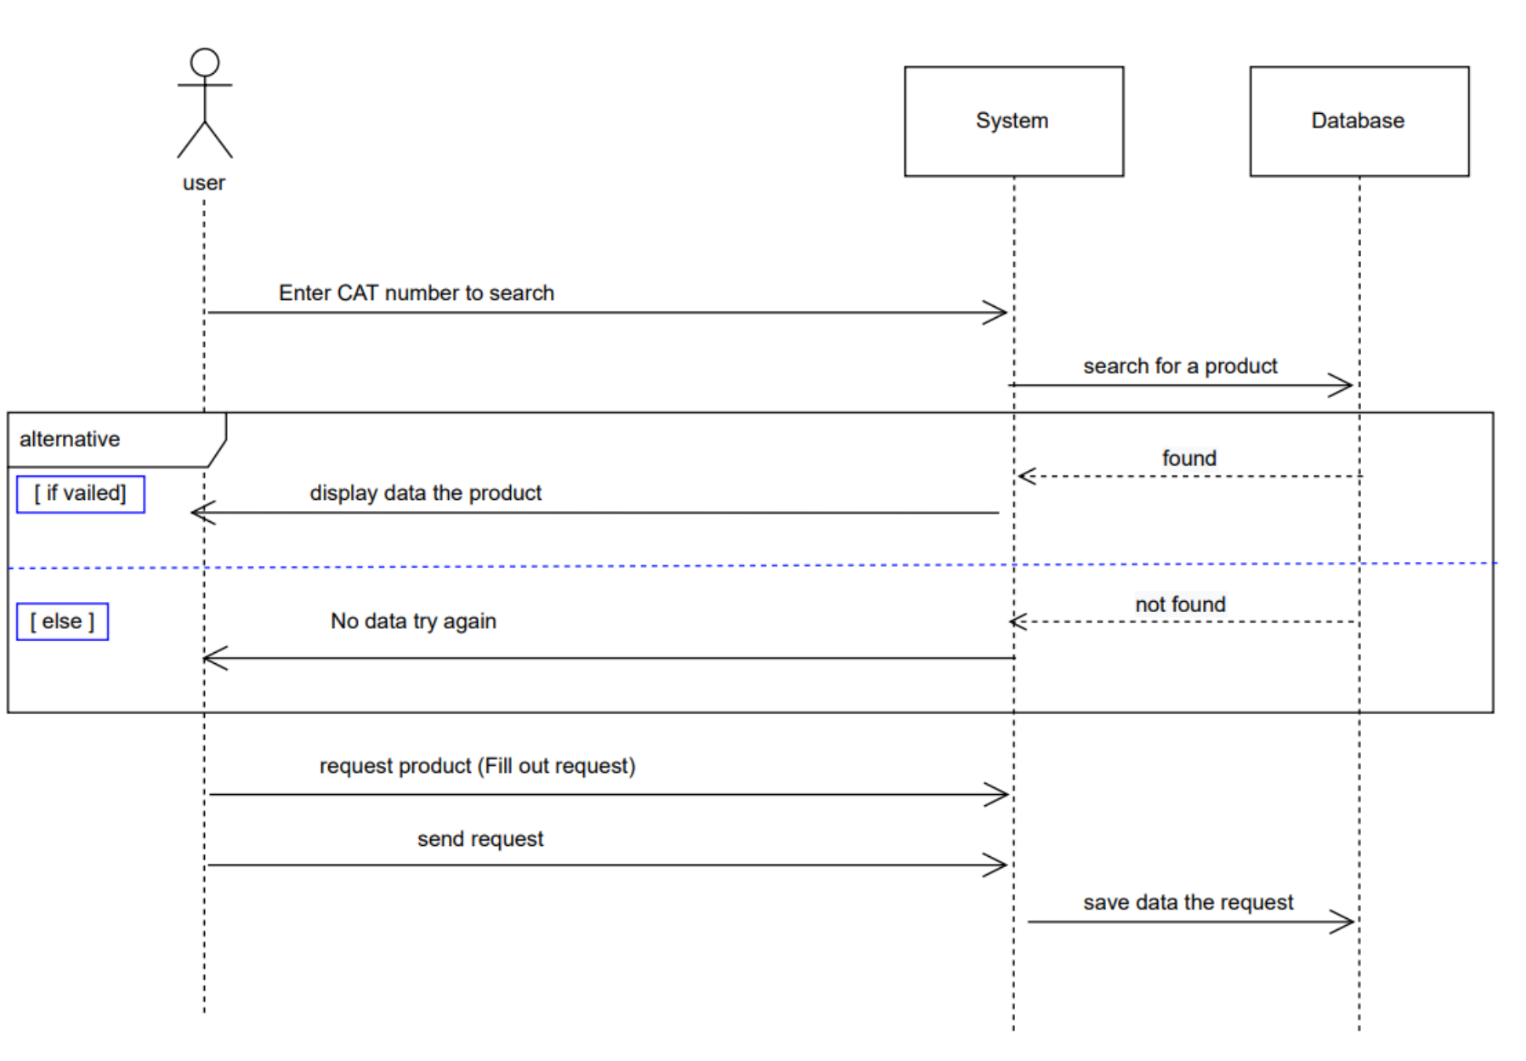
Sequence diagram for tow implement requirements :
Search for a product and Request product

Slide 30
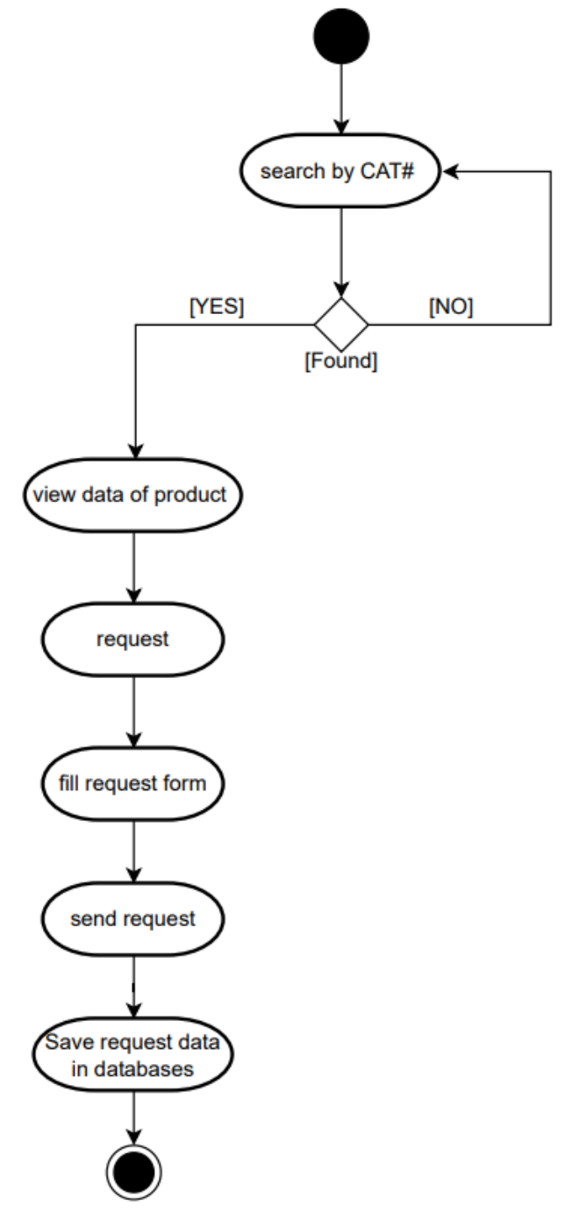
Activity diagram for tow implement requirements :
* Search for a product
and Request product

Slide 31

Implementations

Slide 32

Programming language & Tools
Core function implemented
Testing
The steps of implement the core functions step
unit testing of the core functions we did in this sprint
1-We used Visual Studio 2019 it is an integrated development environment from Microsoft. It is used to develop computer programs, as well as websites and web applications.
2. For back-end development, we used PHP and MySQL languages and we also used to develop interfaces HTML and CSS.

Slide 33
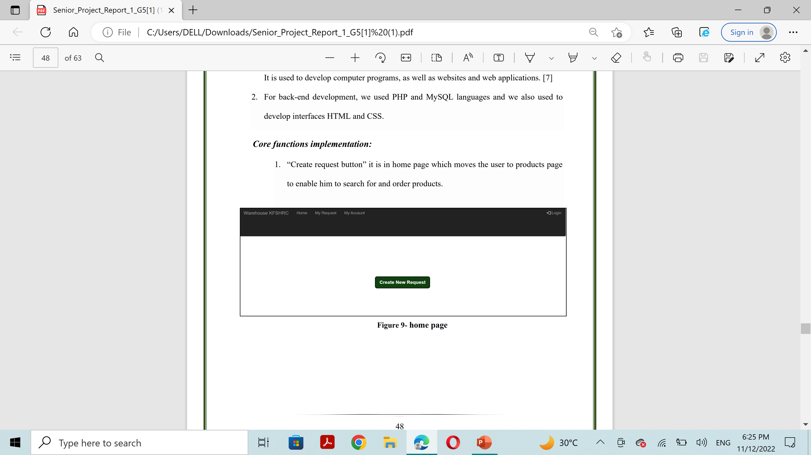
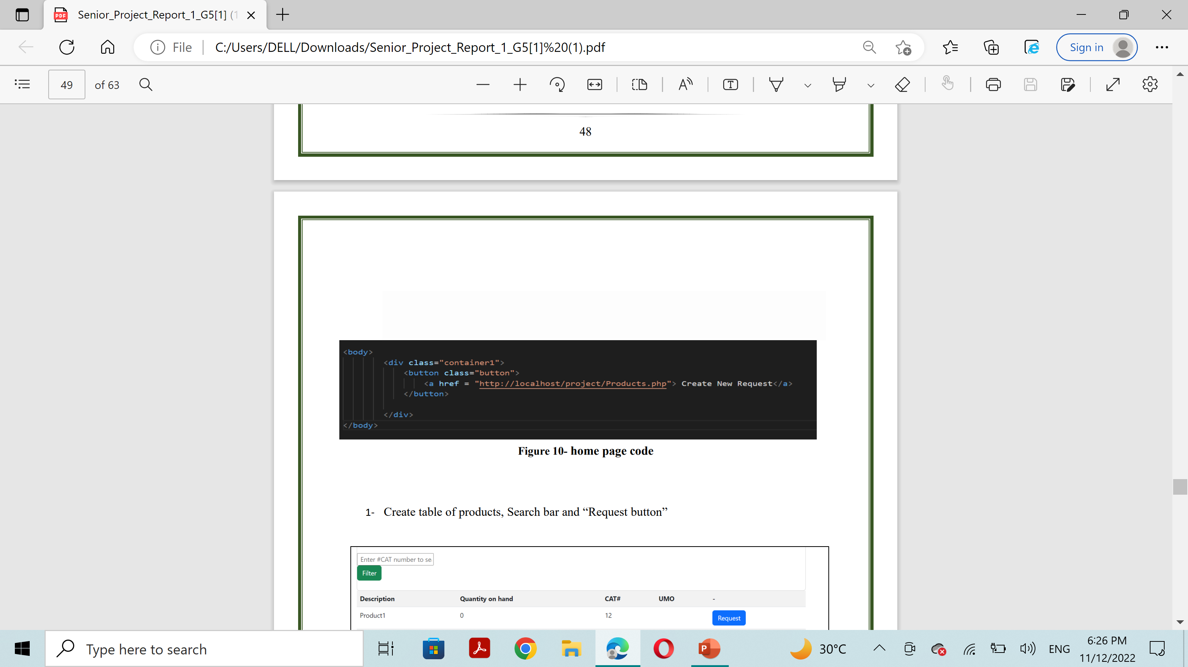
Core Functions Implementations

Slide 34
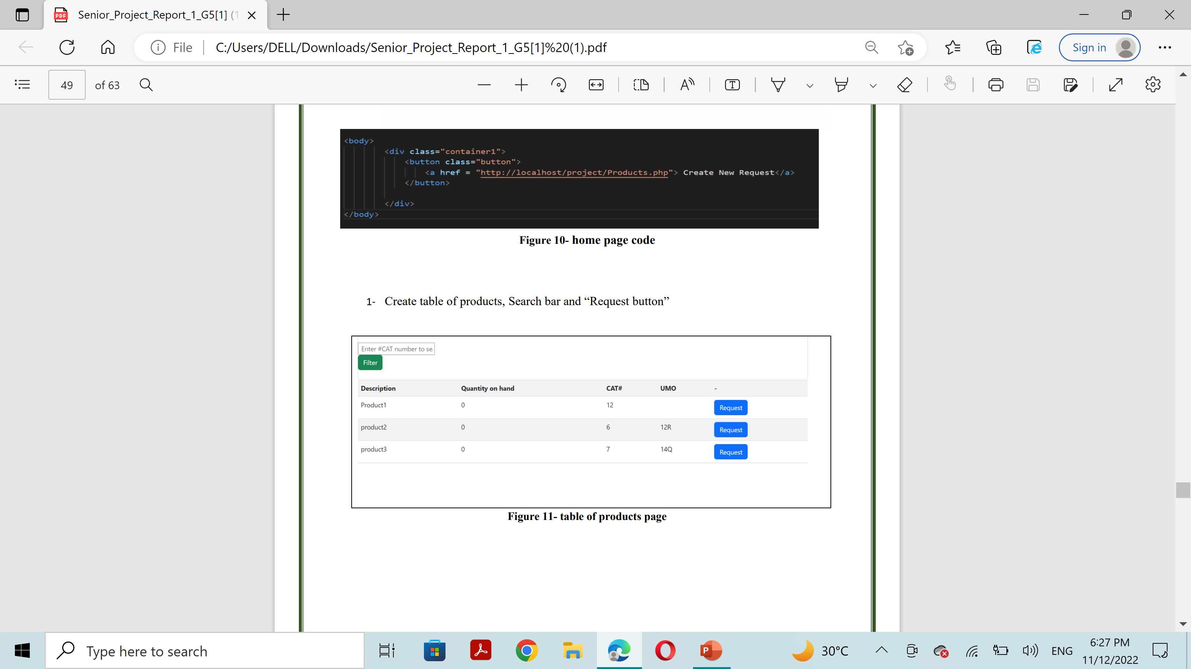
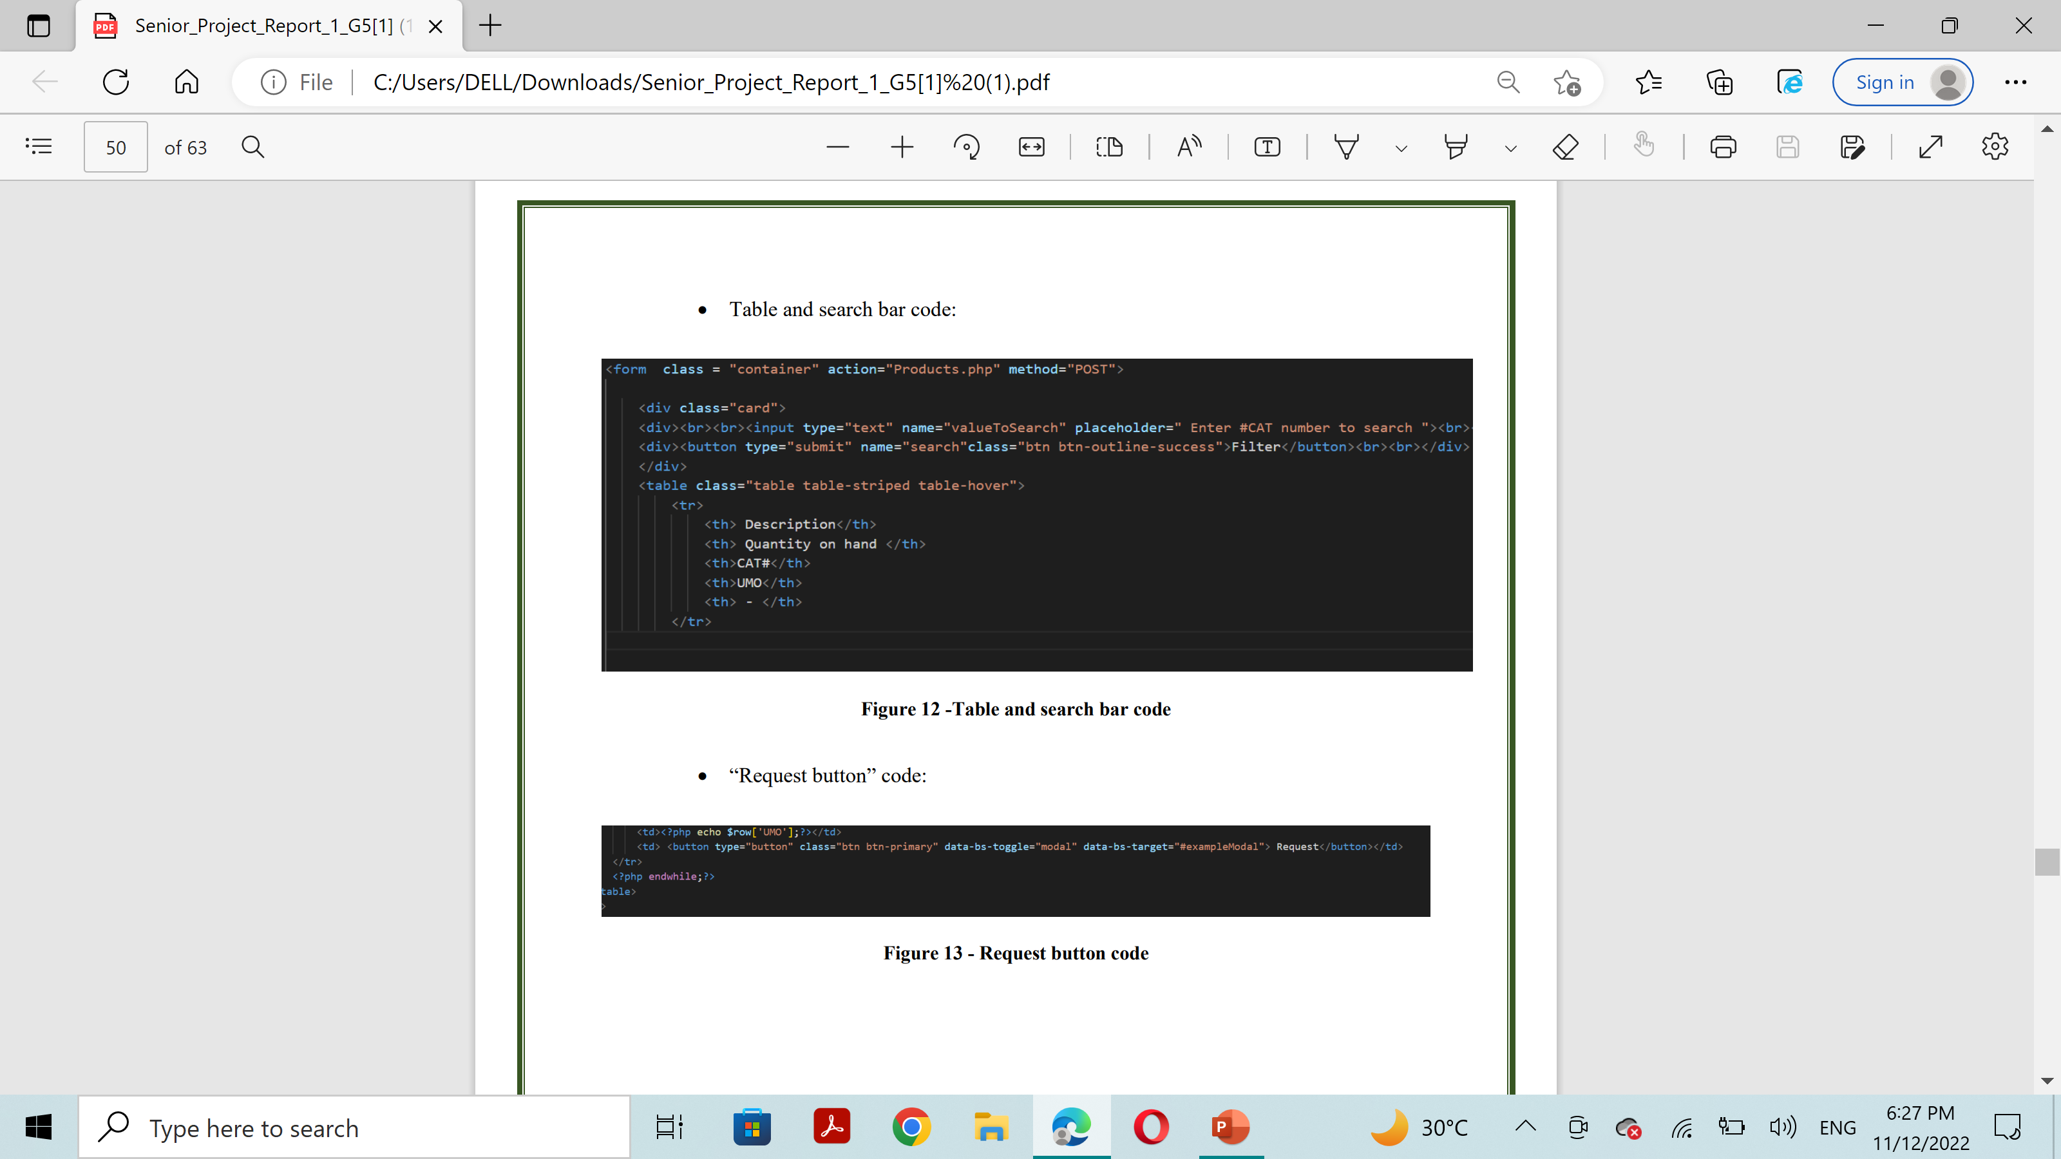
Core Functions Implementations

Slide 35
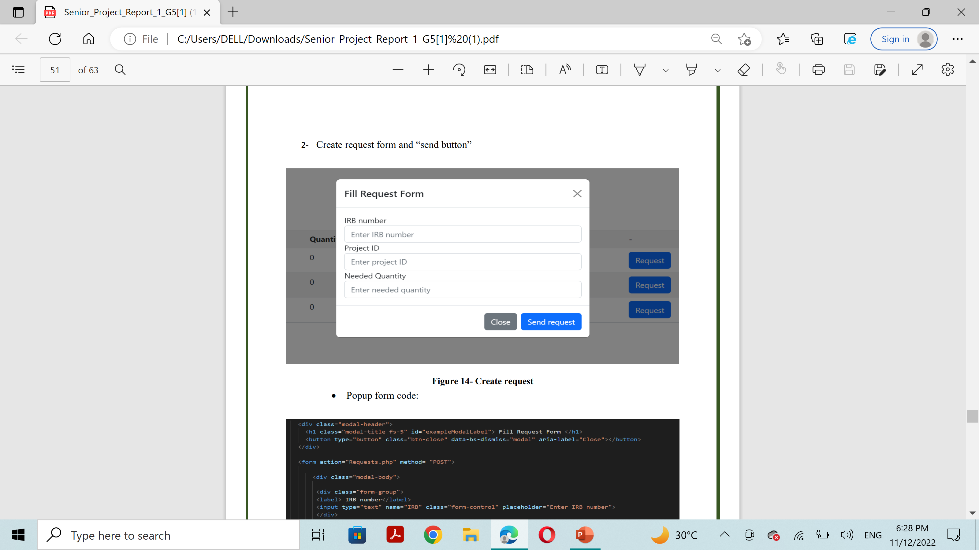
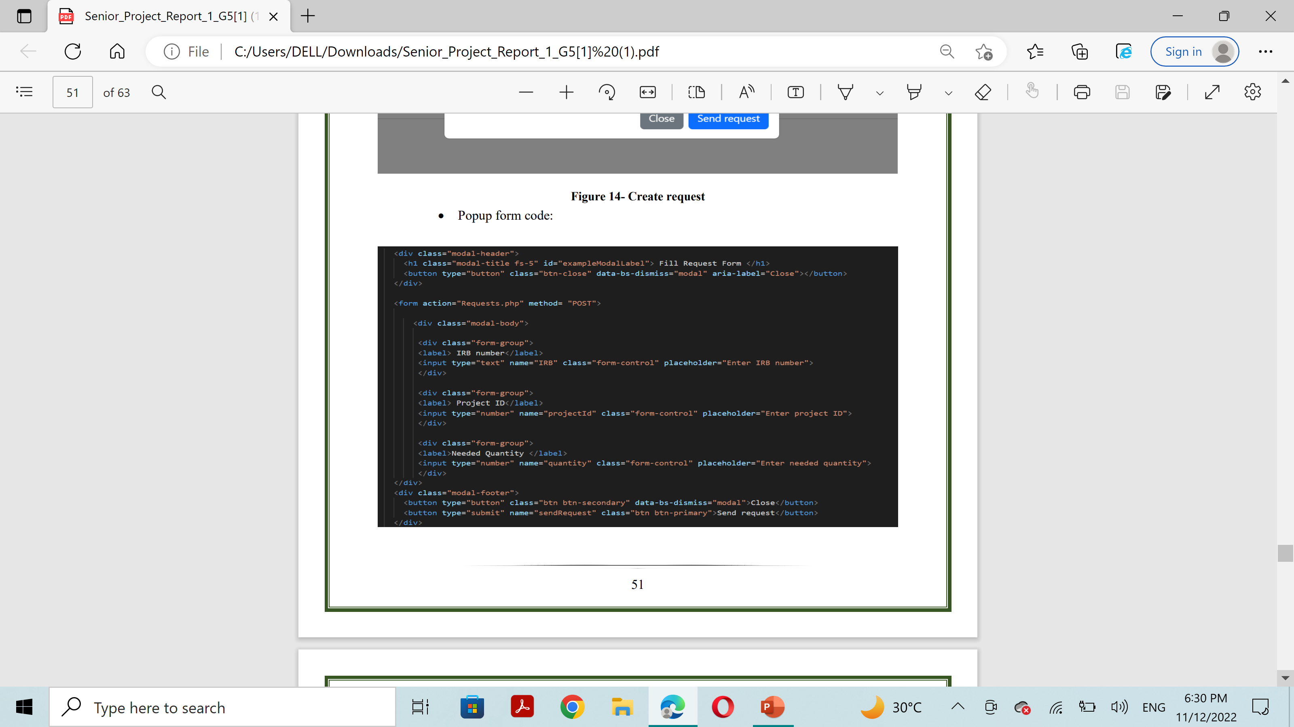
Core Functions Implementations

Slide 36
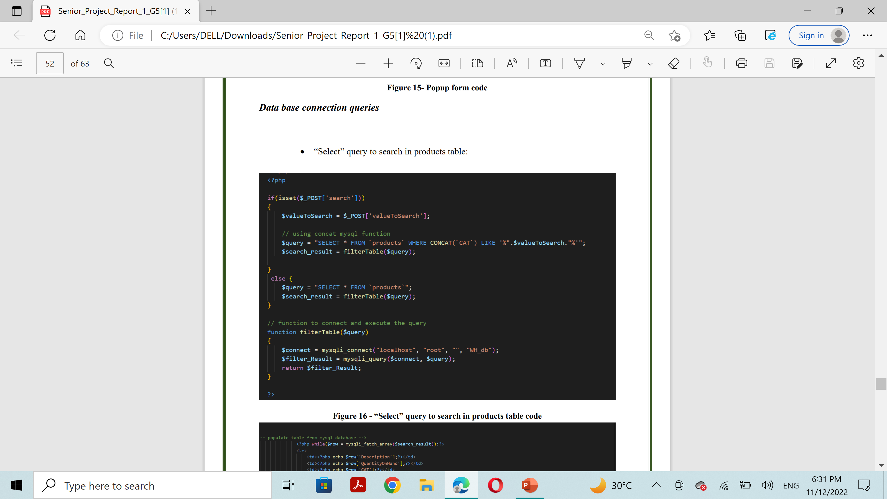
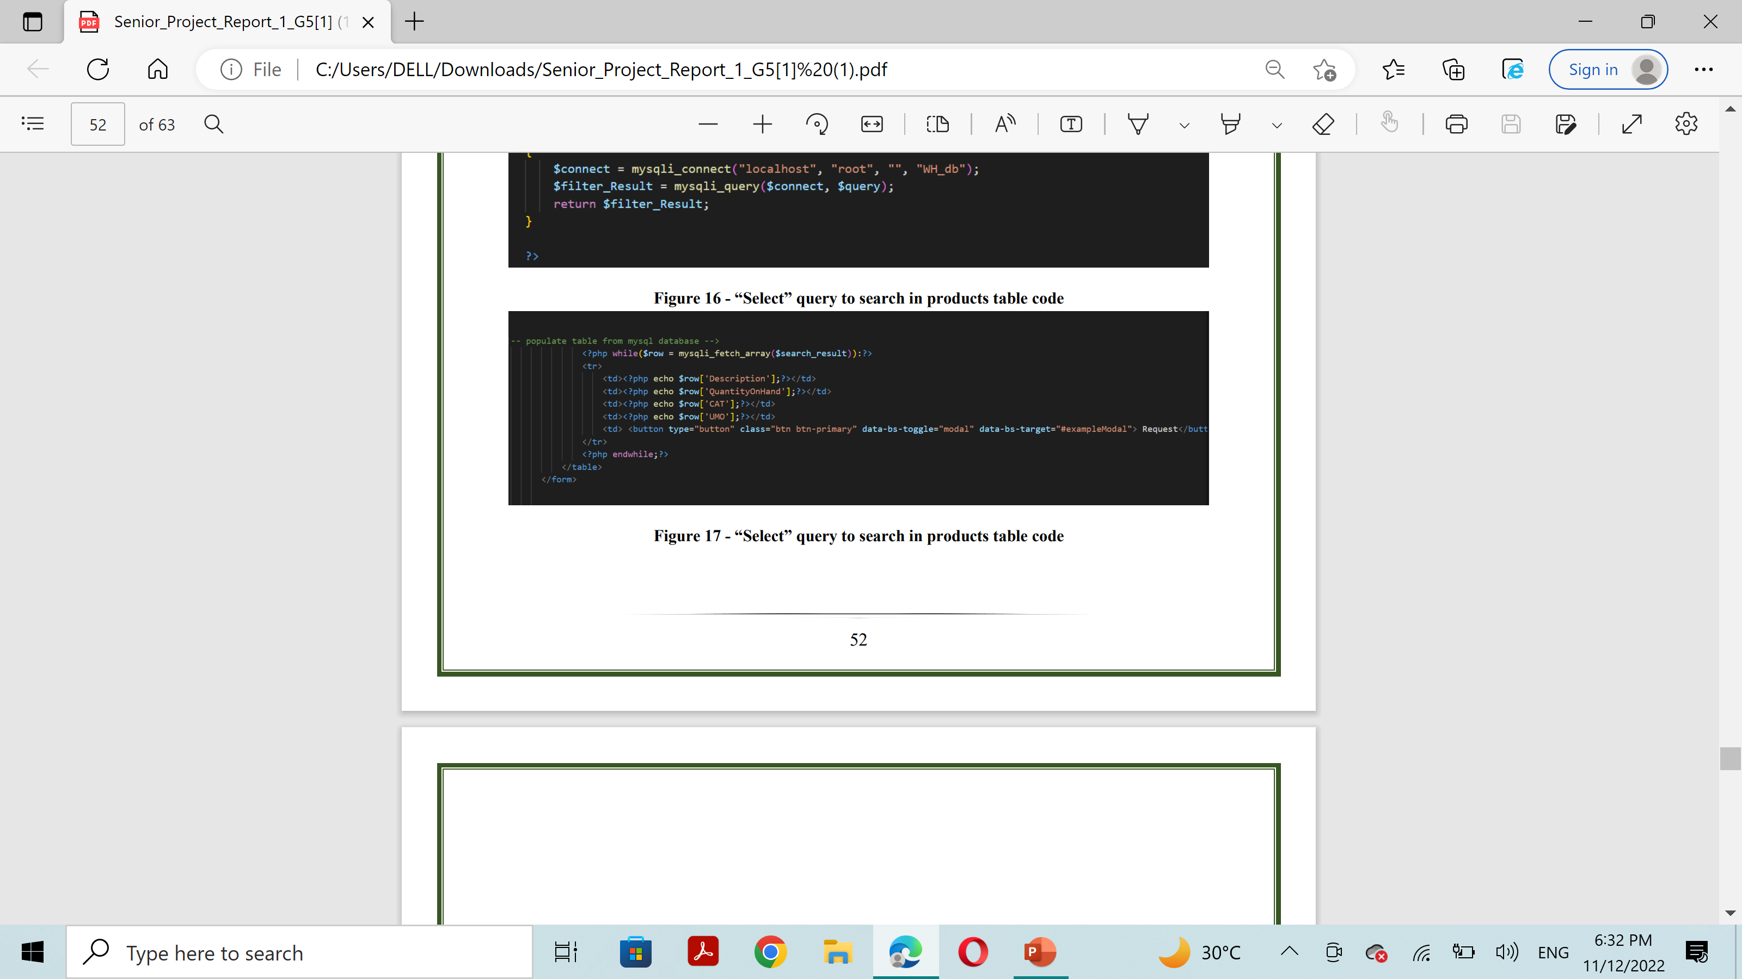
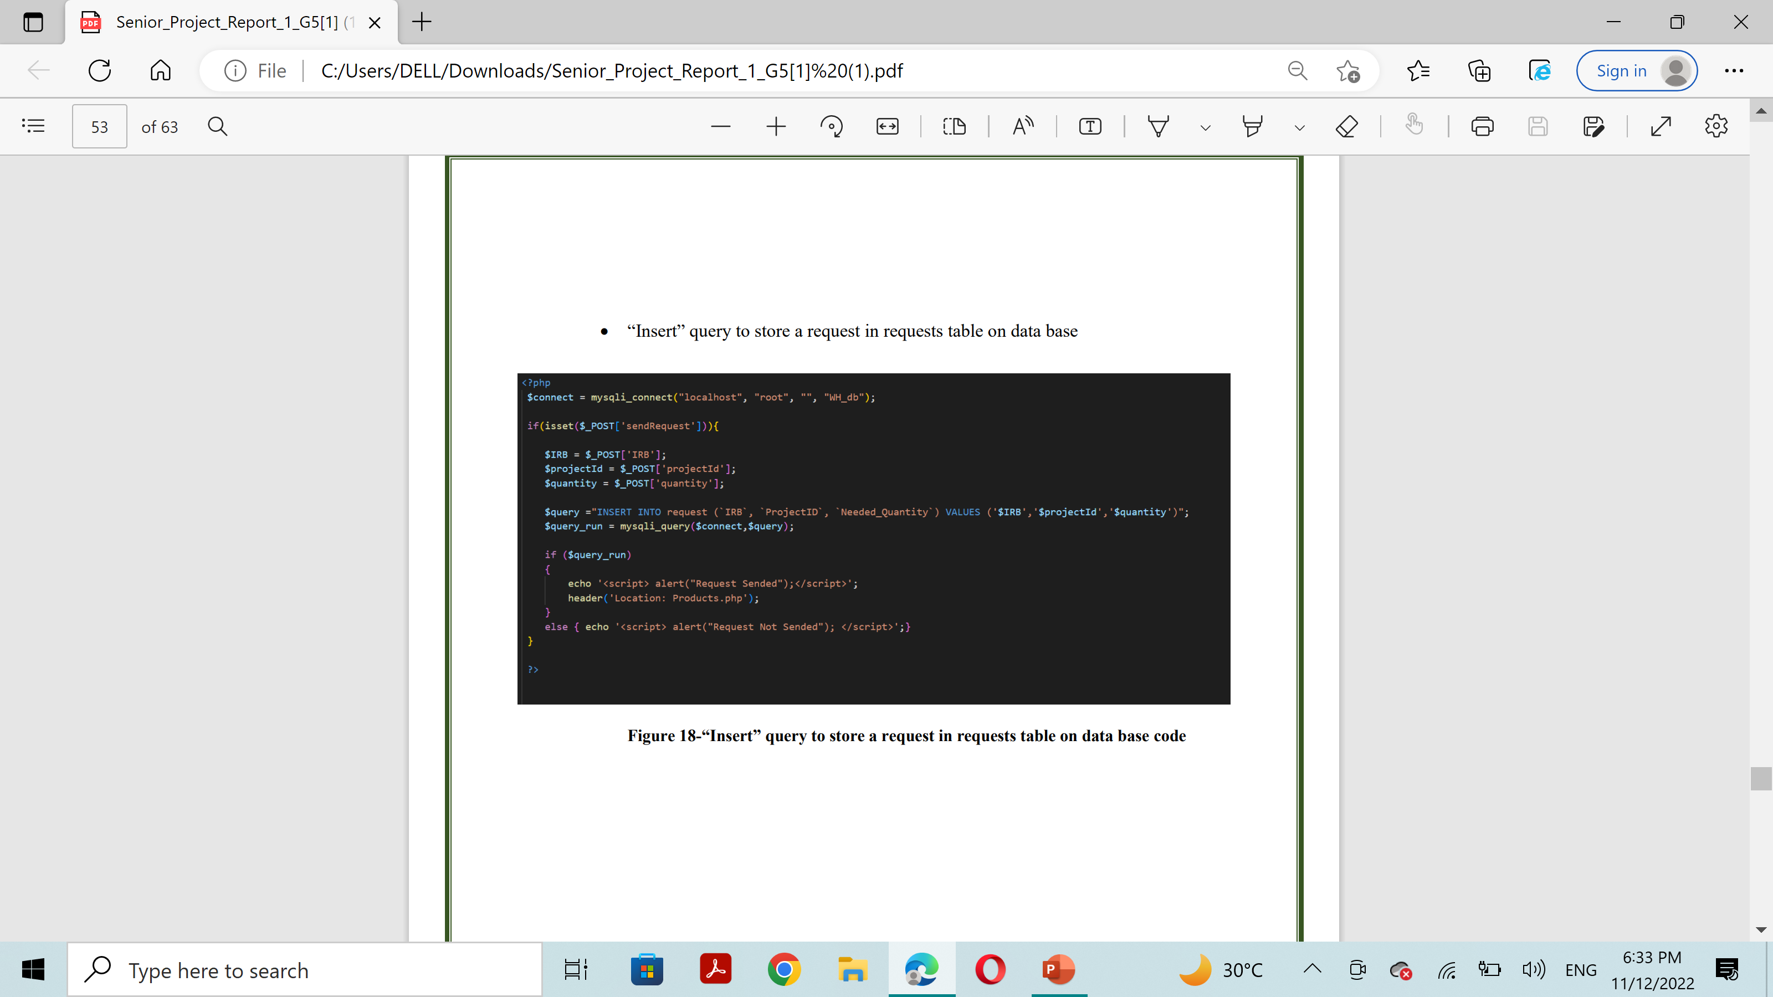
Core Functions Implementations

Slide 37
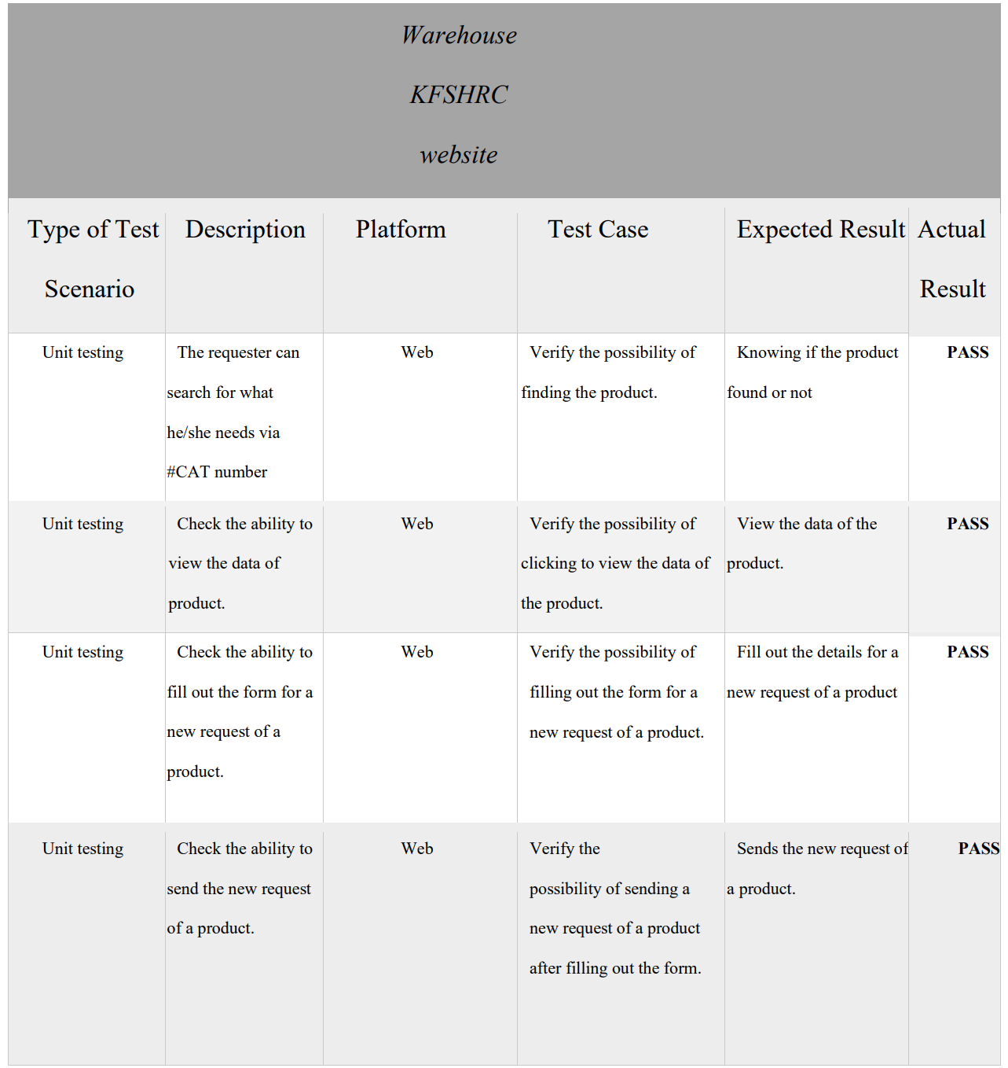
Testing

Slide 38


Conclusion
In conclusion, Technology exists to make people's lives easier and solve their problems. We at WAREHOUSE OF KFSHRC are trying to help the Warehouse Administrator in facilitating his operations and organizing them into a system. and In this report we have clarified the two selected requirements and the implementation code that showed us the required output, and use the sequence diagram to illustrate how the different parts of a system interact with each other to carry out a function, and the order in which the interactions occur when a particular use case is executed. also use activity diagram shows business and software processes as a progression of actions

